Slide 1
Week 6 – Various Diffusion Space
Mastering Diffusion
Latent Diffusion Models and Discrete Space Diffusion Models
Jihwan Hong
AIDAS Lab
Seoul National University
csjihwanh@snu.ac.kr

Slide 2
Latent Space Diffusion

Slide 3
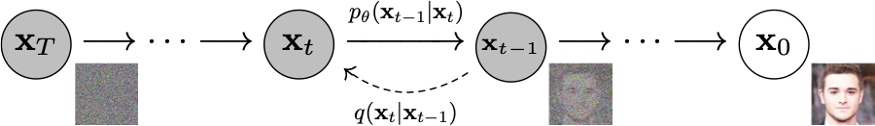
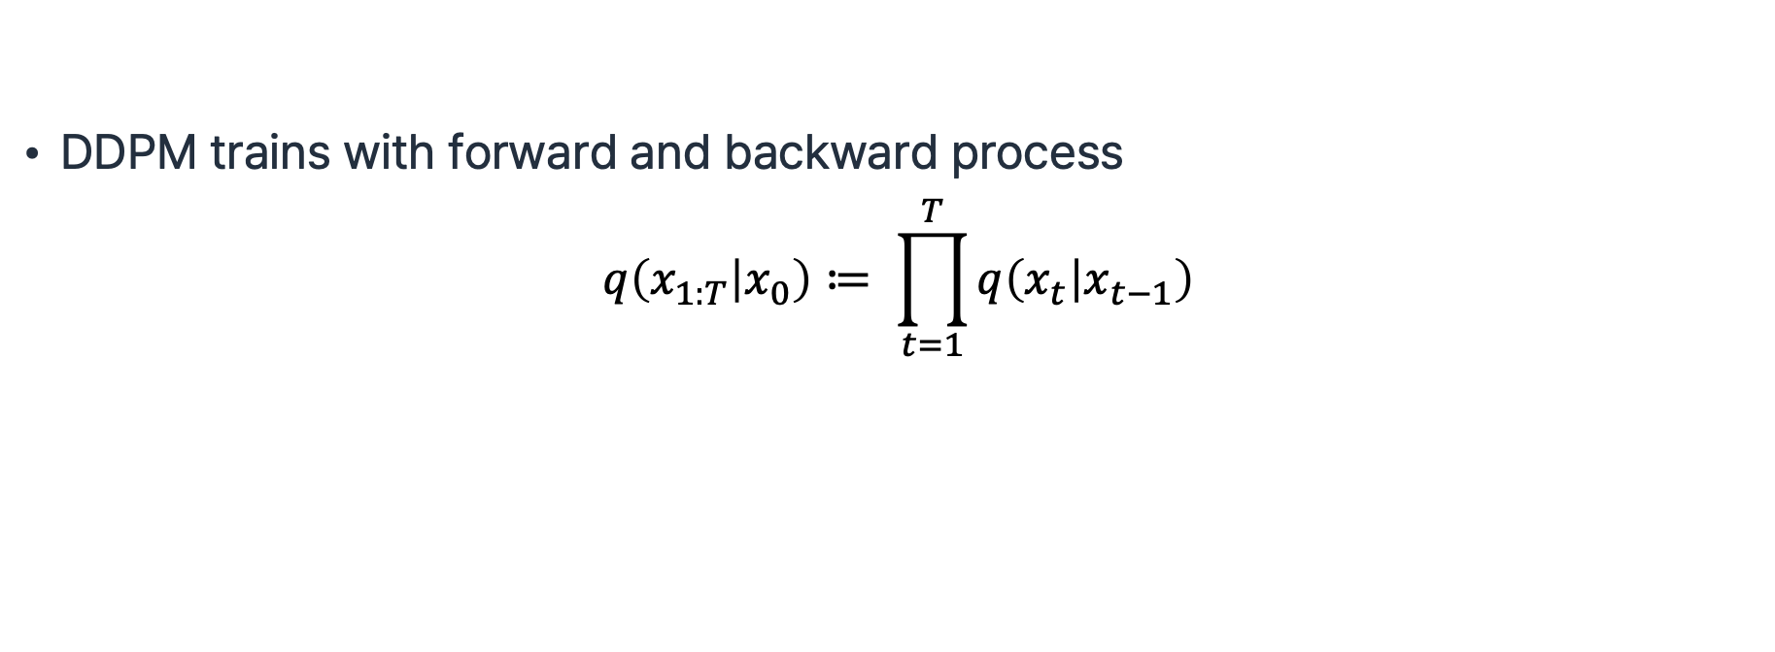
Recap: Diffusion Models
DDPM trains with forward and backward process
$$q\left(x_{1:T} | x_{0}\right)≔ \prod_{t=1}^{T}{q\left(x_{t} | x_{t−1}\right)}$$
Ho et al., “Denoising Diffusion Probabilistic Models”, NeurIPS 2020.
Notes:
=

Slide 4
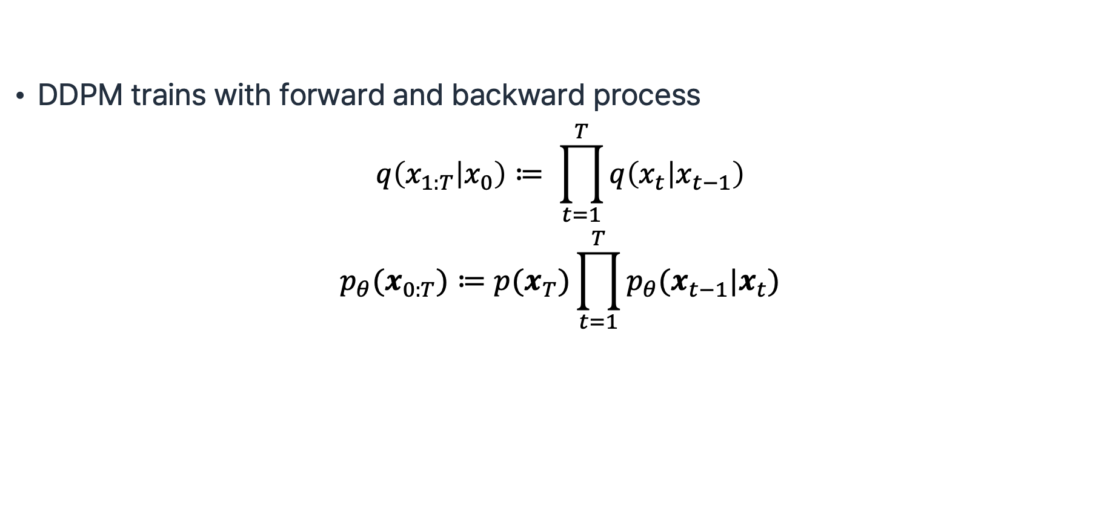
Recap: Diffusion Models
DDPM trains with forward and backward process
$$q\left(x_{1:T} | x_{0}\right)≔ \prod_{t=1}^{T}{q\left(x_{t} | x_{t−1}\right)}$$
$$p_{θ}(x_{0:T})≔p(x_{T})\prod_{t=1}^{T}{p_{θ}(x_{t−1}|x_{t})}$$
Ho et al., “Denoising Diffusion Probabilistic Models”, NeurIPS 2020.

Slide 5

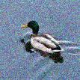
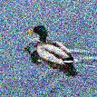





DDPM Implementation
Forward Process: $q\left(x_{t} | x_{t−1}\right)≔ 𝒩(x_{t};\sqrt{1−β_{t}}x_{t−1},β_{t}I)$
$$x_{0}$$
$$x_{t−1}$$
$$x_{t}$$
$$x_{T}$$

Slide 6
DDPM Implementation
Forward Process: $q\left(x_{t} | x_{t−1}\right)≔ 𝒩(x_{t};\sqrt{1−β_{t}}x_{t−1},β_{t}I)$
$$x_{0}$$
$$x_{t−1}$$
$$x_{t}$$
$$x_{T}$$
Backward Process: $p_{θ}\left(x_{t−1} | x_{t}\right)≔ 𝒩(x_{t−1},μ_{θ}\left(x_{t}, t\right),Σ_{θ}\left(x_{t},t\right))$

Slide 7

DDPM Implementation
Forward Process: $q\left(x_{t} | x_{t−1}\right)≔ 𝒩(x_{t};\sqrt{1−β_{t}}x_{t−1},β_{t}I)$
$$x_{0}$$
$$x_{t−1}$$
$$x_{t}$$
$$x_{T}$$
Backward Process: $p_{θ}\left(x_{t−1} | x_{t}\right)≔ 𝒩(x_{t−1},μ_{θ}\left(x_{t}, t\right),Σ_{θ}\left(x_{t},t\right))$
Recall (Week 4): The only thing the model needs to predict is the epsilon
$$μ_{θ}\left(x_{t},t\right)=\frac{1}{\sqrt{α_{t}}}\left(x_{t}−\frac{β_{t}}{\sqrt{1−\overline{α_{t}}}}ε_{θ}(x_{t},t)\right)$$

Slide 8
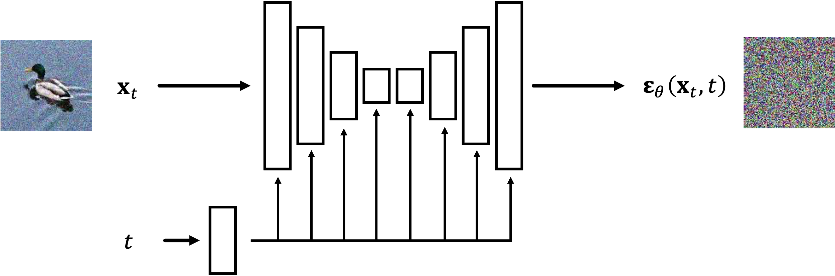
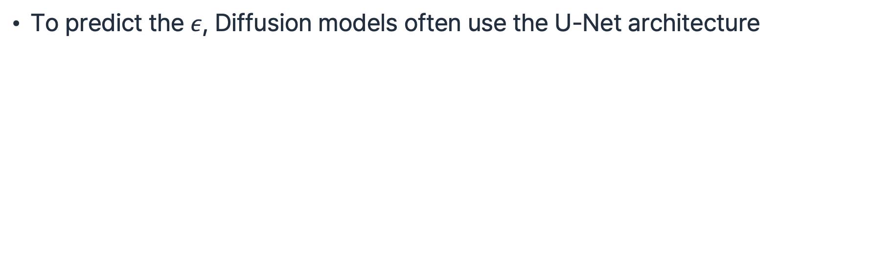
DDPM Implementation
To predict the $ε$, Diffusion models often use the U-Net architecture

Slide 9
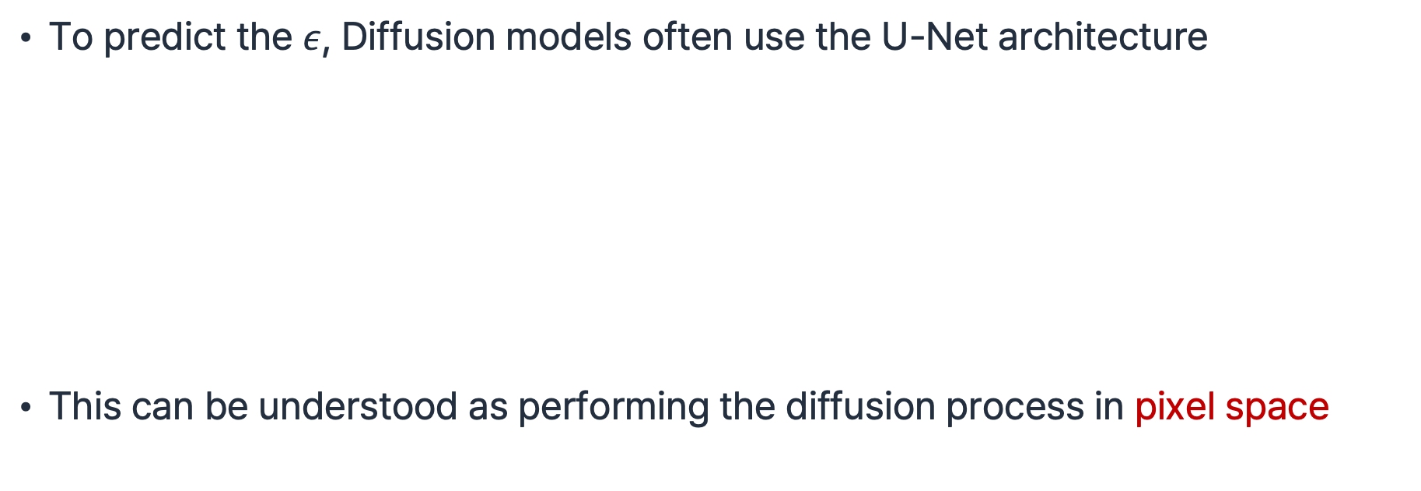
DDPM Implementation
To predict the $ε$, Diffusion models often use the U-Net architecture
This can be understood as performing the diffusion process in pixel space

Slide 10
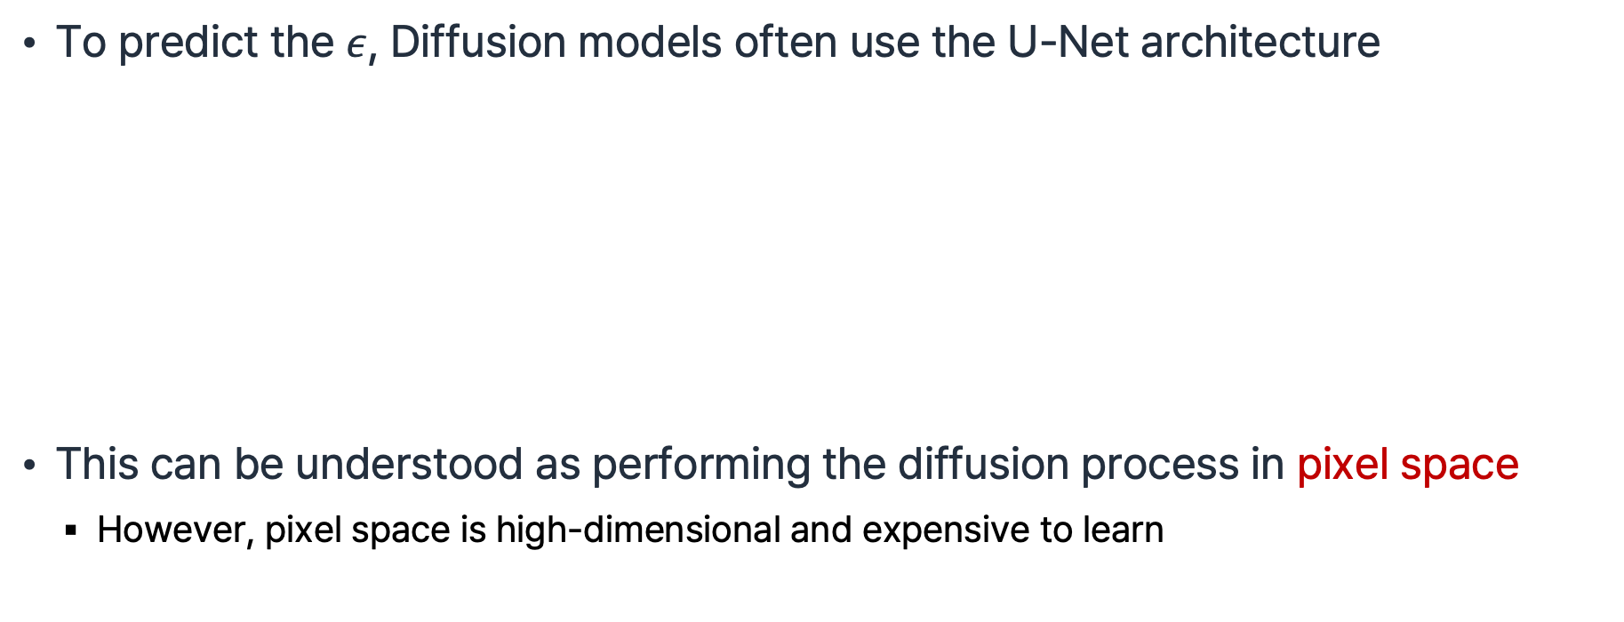
DDPM Implementation
To predict the $ε$, Diffusion models often use the U-Net architecture
This can be understood as performing the diffusion process in pixel space
  However, pixel space is high-dimensional and expensive to learn

Slide 11
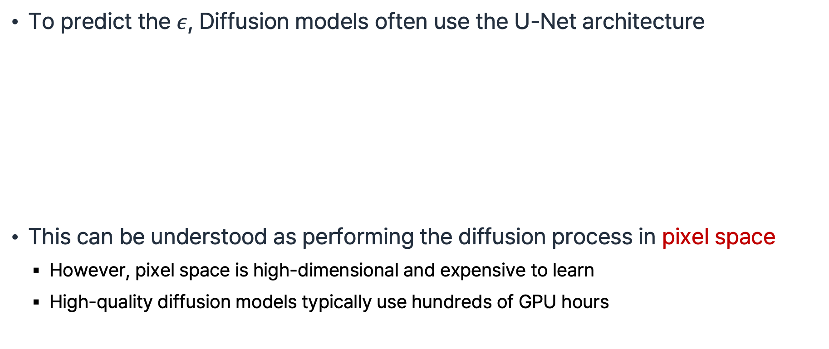
DDPM Implementation
To predict the $ε$, Diffusion models often use the U-Net architecture
This can be understood as performing the diffusion process in pixel space
  However, pixel space is high-dimensional and expensive to learn
  High-quality diffusion models typically use hundreds of GPU hours

Slide 12
DDPM Implementation
To predict the $ε$, Diffusion models often use the U-Net architecture
This can be understood as performing the diffusion process in pixel space
  However, pixel space is high-dimensional and expensive to learn
  High-quality diffusion models typically use hundreds of GPU hours
-> Reduce the dimension by predicting p(x) in latent space

Slide 13



Latent Diffusion Model
$$x_{t}$$
$$ε_{θ}\left(x_{t},t\right)$$
$$t$$

Slide 14




Latent Diffusion Model
$$ℰ$$
$$z_{t}$$
$$x_{t}$$
$$ε_{θ}\left(z_{t},t\right)$$
$$t$$
R. Rombach et al., “High-Resolution Image Synthesis with Latent Diffusion Models”, CVPR 2022.

Slide 15
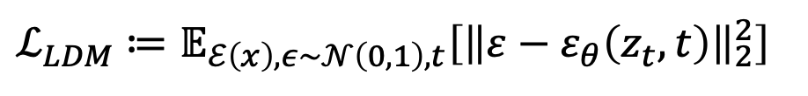
Latent Diffusion Model
$$ℰ$$
$$z_{t}$$
$$x_{t}$$
$$ε_{θ}\left(z_{t},t\right)$$
$$t$$
$$ℒ_{LDM}≔𝔼_{ℰ\left(x\right),ε\sim 𝒩\left(0,1\right),t}\left[{\left\|ε−ε_{θ}\left(z_{t},t\right)\right\|}_{2}^{2}\right]$$
R. Rombach et al., “High-Resolution Image Synthesis with Latent Diffusion Models”, CVPR 2022.

Slide 16
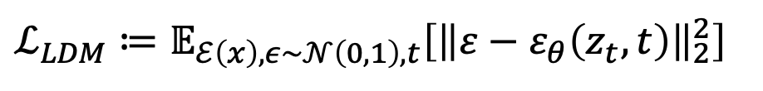
Latent Diffusion Model
$$ℰ$$
$$z_{t}$$
$$x_{t}$$
$$ε_{θ}\left(z_{t},t\right)$$
$$t$$
$$ℒ_{LDM}≔𝔼_{ℰ\left(x\right),ε\sim 𝒩\left(0,1\right),t}\left[{\left\|ε−ε_{θ}\left(z_{t},t\right)\right\|}_{2}^{2}\right]$$
cf. $ℒ_{DDPM}≔𝔼_{x,ε\sim 𝒩\left(0,1\right),t}\left[{\left\|ε−ε_{θ}\left(x_{t},t\right)\right\|}_{2}^{2}\right]$
R. Rombach et al., “High-Resolution Image Synthesis with Latent Diffusion Models”, CVPR 2022.

Slide 17
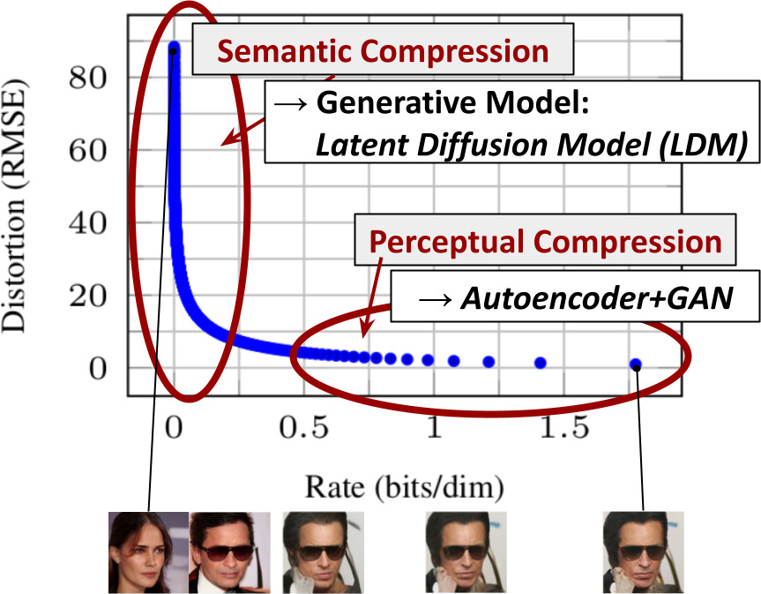
Latent Diffusion Model
R. Rombach et al., “High-Resolution Image Synthesis with Latent Diffusion Models”, CVPR 2022.

Slide 18
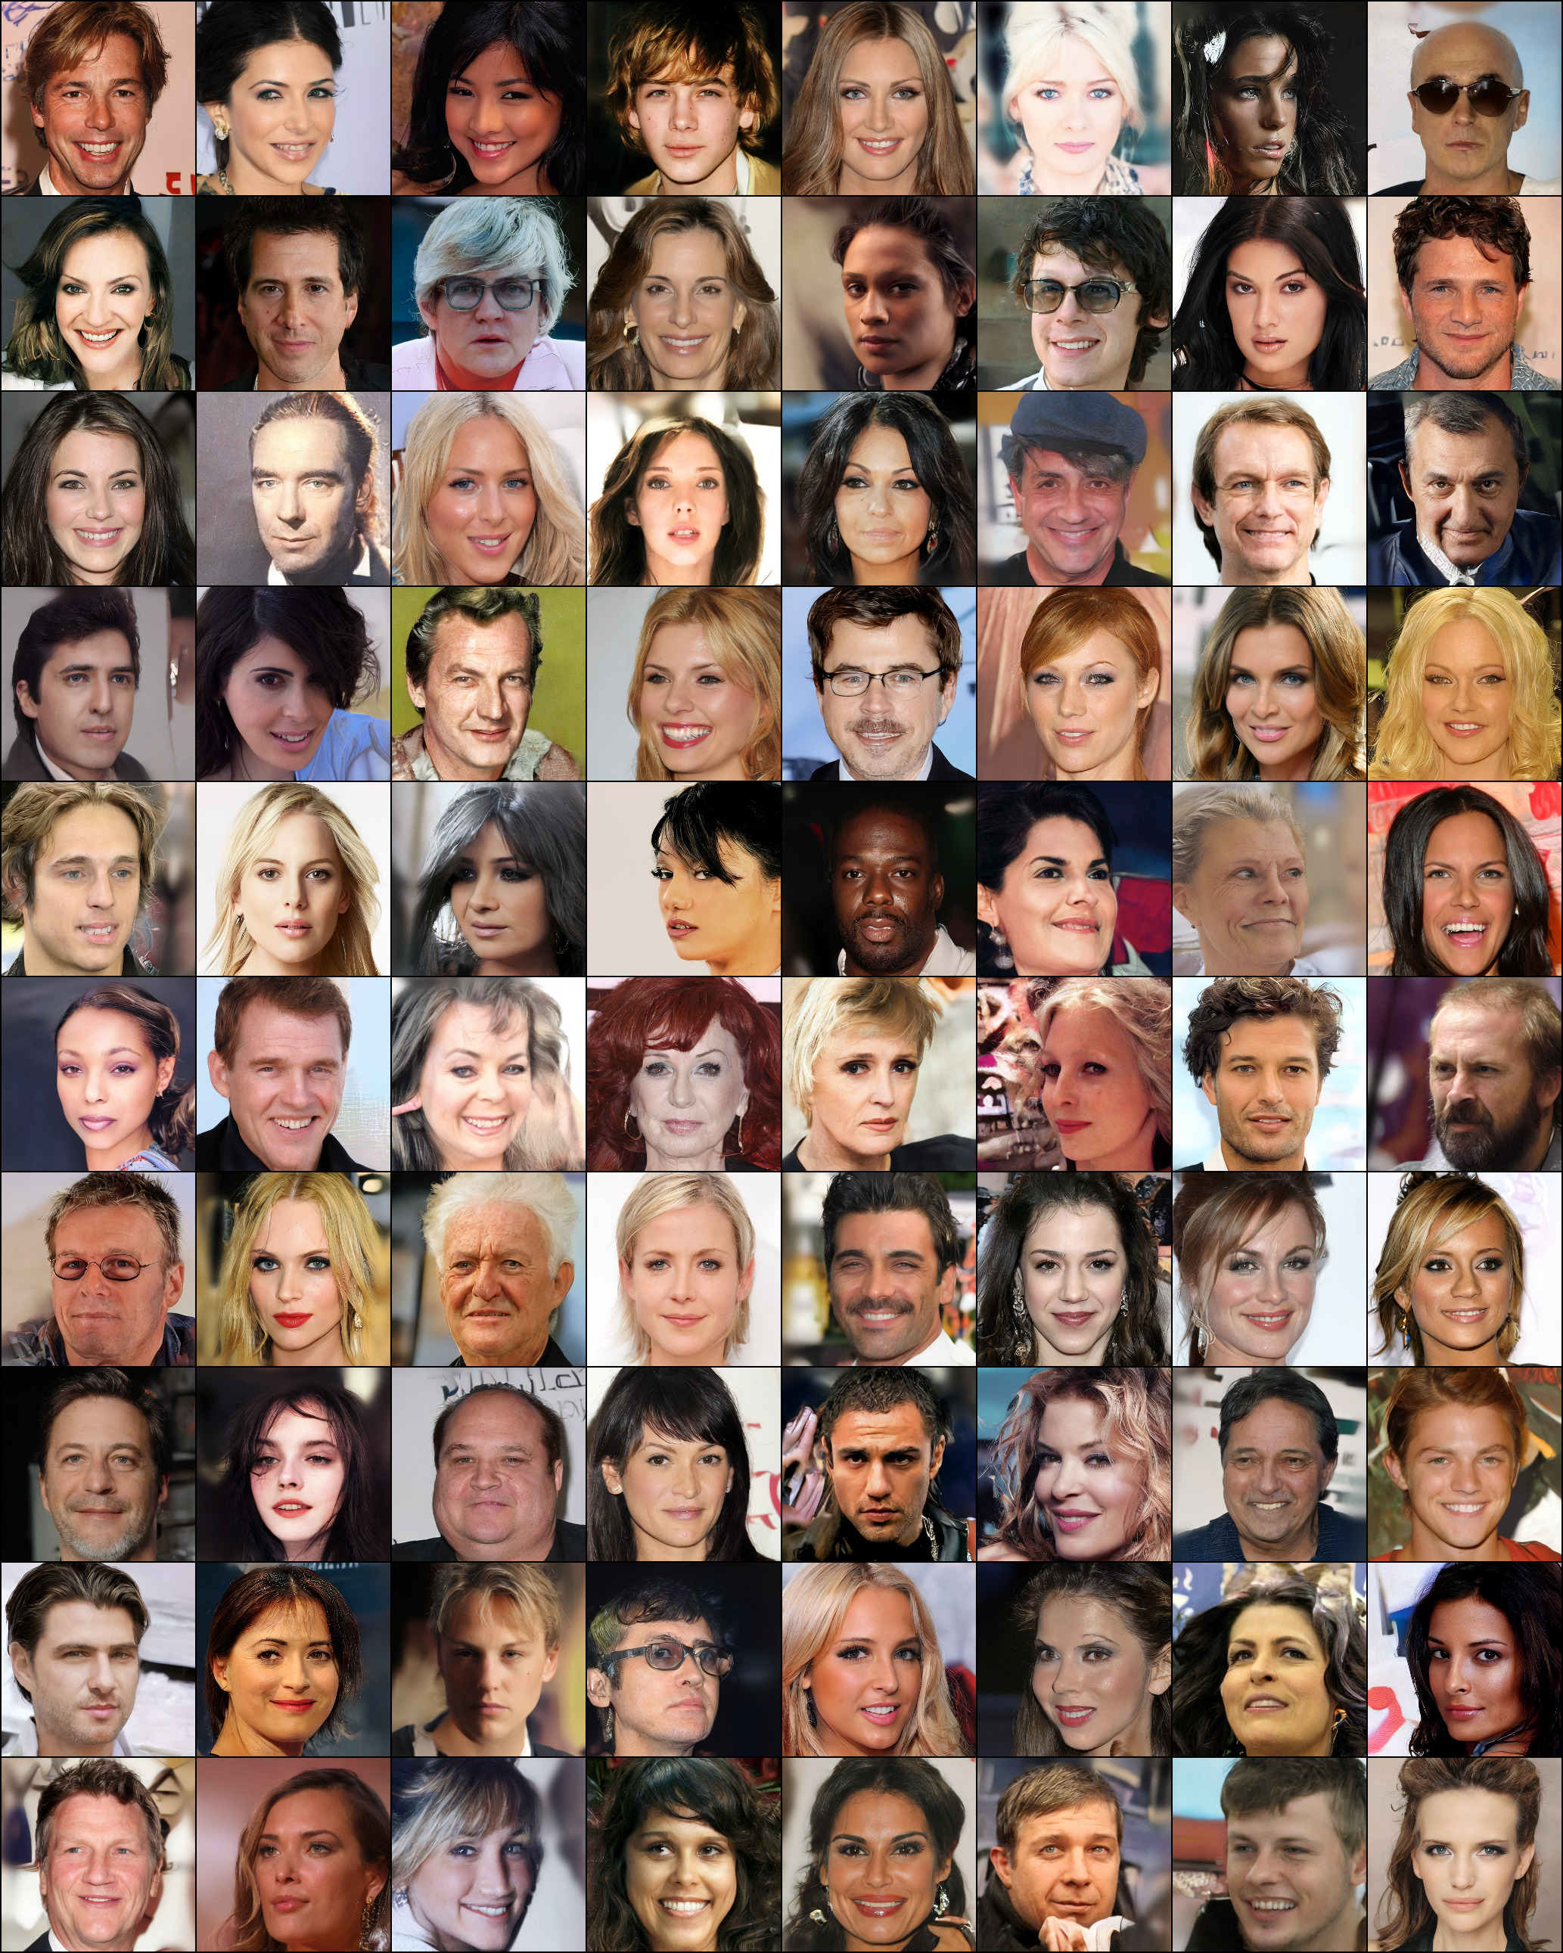
R. Rombach et al., “High-Resolution Image Synthesis with Latent Diffusion Models”, CVPR 2022.

Slide 19
Diffusion Transformer (DiT)
W. Peebles et al., “Scalable Diffusion Models with Transformers”, ICCV 2023 Oral.

Slide 20
Diffusion Transformer (DiT)
LDM diffusion space is not in pixel space anymore
W. Peebles et al., “Scalable Diffusion Models with Transformers”, ICCV 2023 Oral.

Slide 21
Diffusion Transformer (DiT)
LDM diffusion space is not in pixel space anymore
Thus, U-Net inductive bias is not crucial for diffusion models
W. Peebles et al., “Scalable Diffusion Models with Transformers”, ICCV 2023 Oral.

Slide 22
Diffusion Transformer (DiT)
LDM diffusion space is not in pixel space anymore
Thus, U-Net inductive bias is not crucial for diffusion models
Transformer architecture can be utilized for LDM
W. Peebles et al., “Scalable Diffusion Models with Transformers”, ICCV 2023 Oral.

Slide 23

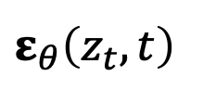

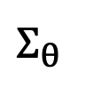


Diffusion Transformer (DiT)
LDM diffusion space is not in pixel space anymore
Thus, U-Net inductive bias is not crucial for diffusion models
Transformer architecture can be utilized for LDM
Transformer
$$ℰ$$
$$z_{t}$$
$$ε_{θ}\left(z_{t},t\right)$$
$$x_{t}$$
$$Σ_{θ}$$
$$t$$
Embed
W. Peebles et al., “Scalable Diffusion Models with Transformers”, ICCV 2023 Oral.

Slide 24
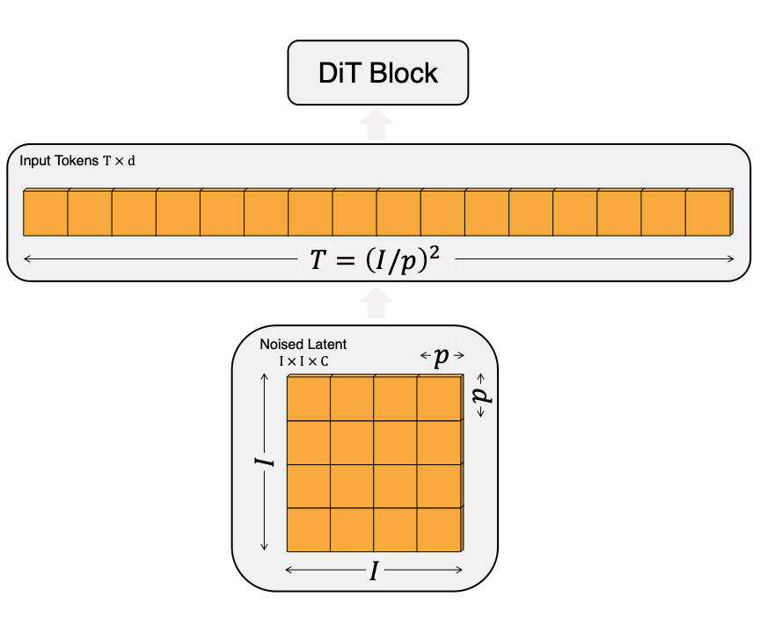
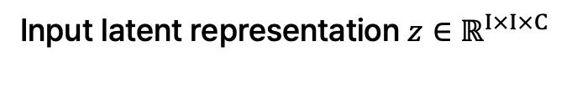
DiT Patchification
Input latent representation $z∈ℝ^{I×I×C}$
W. Peebles et al., “Scalable Diffusion Models with Transformers”, ICCV 2023 Oral.

Slide 25
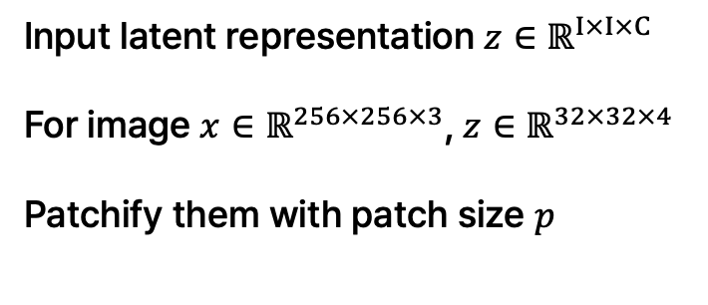
DiT Patchification
Input latent representation $z∈ℝ^{I×I×C}$
For image $x∈ℝ^{256×256×3}$, $z∈ℝ^{32×32×4}$
Patchify them with patch size $p$
W. Peebles et al., “Scalable Diffusion Models with Transformers”, ICCV 2023 Oral.

Slide 26

DiT Patchification
The result is $T={\left(\frac{I}{p}\right)}^{2}$tokens
With each size $d$
Input latent representation $z∈ℝ^{I×I×C}$
For image $x∈ℝ^{256×256×3}$, $z∈ℝ^{32×32×4}$
Patchify them with patch size $p$
W. Peebles et al., “Scalable Diffusion Models with Transformers”, ICCV 2023 Oral.

Slide 27

DiT Patchification
Before feed into the DiT block,
time embedding $t$ or condition $c$ are appended
The result is $T={\left(\frac{I}{p}\right)}^{2}$tokens
With each size $d$
Input latent representation $z∈ℝ^{I×I×C}$
For image $x∈ℝ^{256×256×3}$, $z∈ℝ^{32×32×4}$
Patchify them with patch size $p$
W. Peebles et al., “Scalable Diffusion Models with Transformers”, ICCV 2023 Oral.

Slide 28
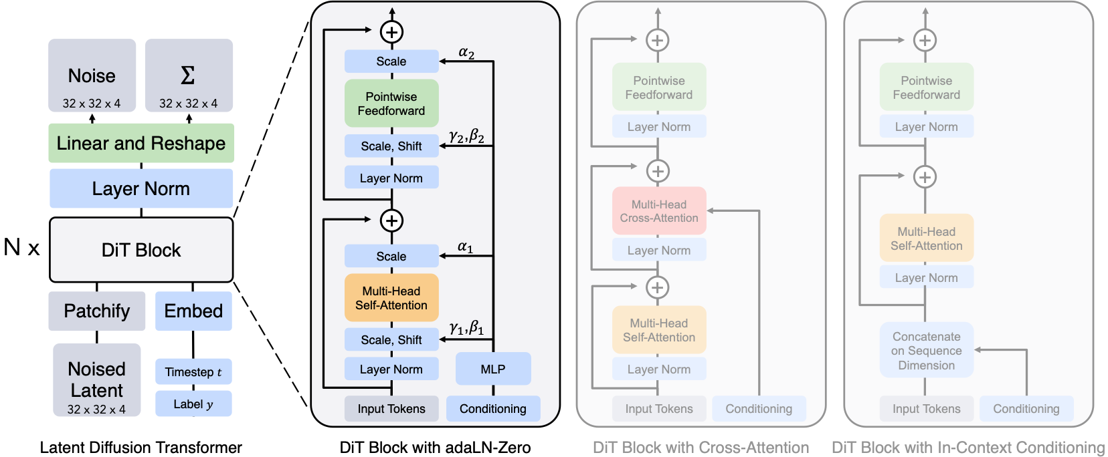
Architectural Detail
W. Peebles et al., “Scalable Diffusion Models with Transformers”, ICCV 2023 Oral.

Slide 29
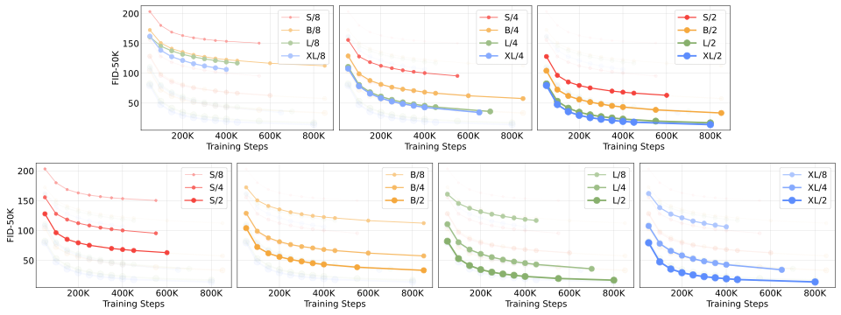
DiT Scalability
W. Peebles et al., “Scalable Diffusion Models with Transformers”, ICCV 2023 Oral.

Slide 30
DiT
W. Peebles et al., “Scalable Diffusion Models with Transformers”, ICCV 2023 Oral.

Slide 31

Score-based Diffusion Process
Recall (week 5): diffusion process as SDE
$$dx(t)= −\frac{1}{2}β\left(t\right)x(t)dt+ \sqrt{β\left(t\right)}dω(t)$$
A. Vahdat et al., “Score-based Generative Modeling in Latent Space”, NeurIPS 2021.

Slide 32
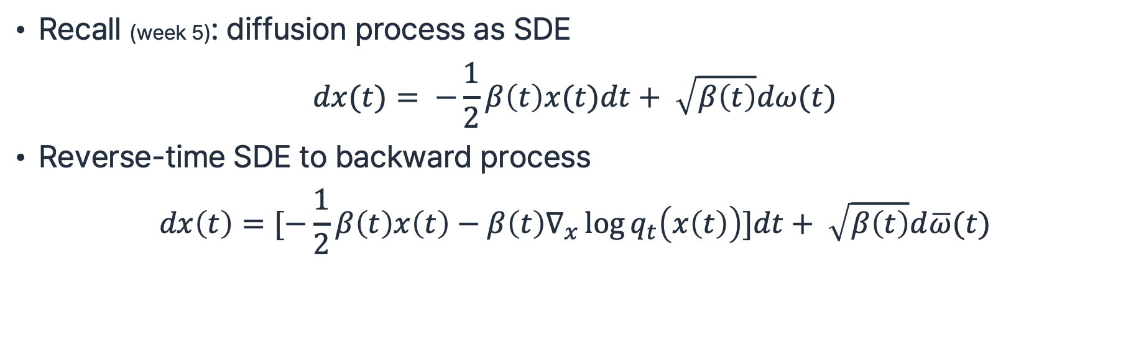
Score-based Diffusion Process
Recall (week 5): diffusion process as SDE
$$dx(t)= −\frac{1}{2}β\left(t\right)x(t)dt+ \sqrt{β\left(t\right)}dω(t)$$
Reverse-time SDE to backward process
$$dx\left(t\right)=[−\frac{1}{2}β\left(t\right)x\left(t\right)−β\left(t\right)∇_{x}\log{q_{t}\left(x\left(t\right)\right)}]dt+ \sqrt{β\left(t\right)}d\overline{ω}(t)$$
A. Vahdat et al., “Score-based Generative Modeling in Latent Space”, NeurIPS 2021.

Slide 33
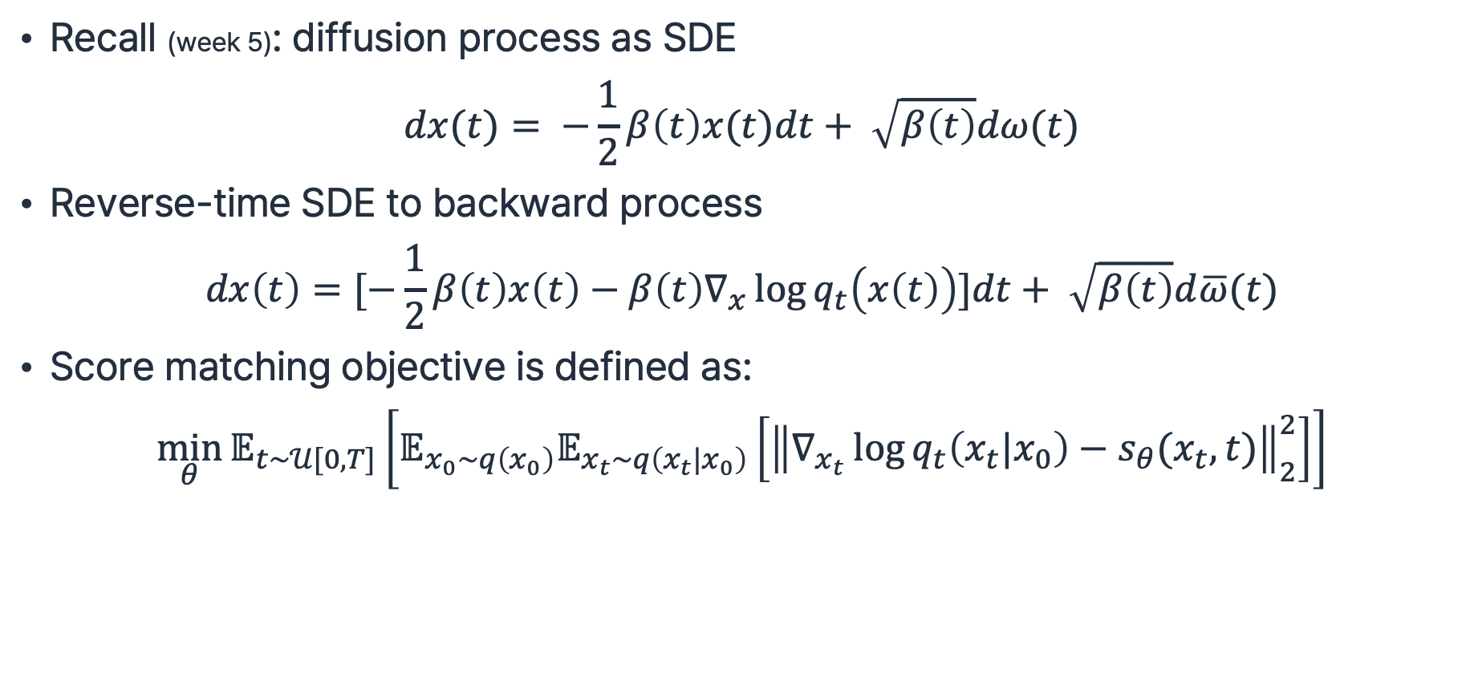
Score-based Diffusion Process
Recall (week 5): diffusion process as SDE
$$dx(t)= −\frac{1}{2}β\left(t\right)x(t)dt+ \sqrt{β\left(t\right)}dω(t)$$
Reverse-time SDE to backward process
$$dx\left(t\right)=[−\frac{1}{2}β\left(t\right)x\left(t\right)−β\left(t\right)∇_{x}\log{q_{t}\left(x\left(t\right)\right)}]dt+ \sqrt{β\left(t\right)}d\overline{ω}(t)$$
Score matching objective is defined as:
$$\min_{θ}{𝔼_{t\sim 𝒰[0,T]}\left[𝔼_{x_{0}\sim q\left(x_{0}\right)}𝔼_{x_{t}\sim q\left(x_{t}|x_{0}\right)}\left[{\left\|∇_{x_{t}}\log{q_{t}\left(x_{t}|x_{0}\right)}−s_{θ}(x_{t},t)\right\|}_{2}^{2}\right]\right]}$$
A. Vahdat et al., “Score-based Generative Modeling in Latent Space”, NeurIPS 2021.

Slide 34
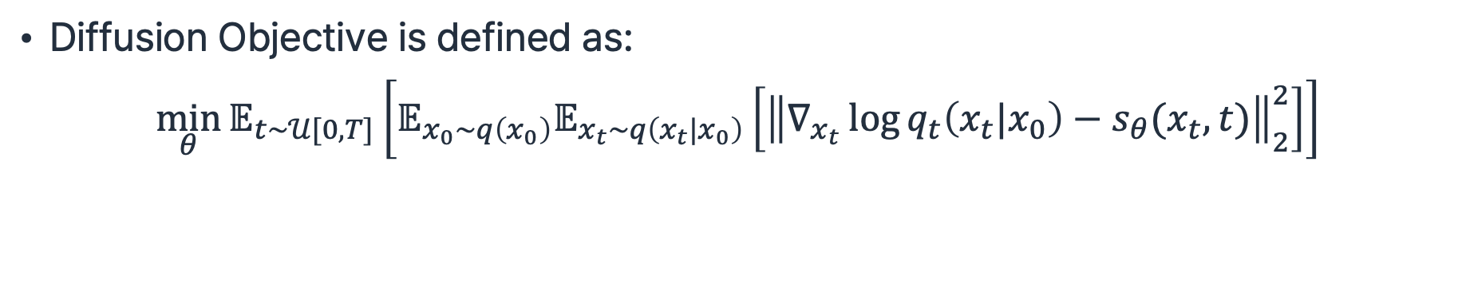
Score-based Diffusion Process
Diffusion Objective is defined as:
$$\min_{θ}{𝔼_{t\sim 𝒰[0,T]}\left[𝔼_{x_{0}\sim q\left(x_{0}\right)}𝔼_{x_{t}\sim q\left(x_{t}|x_{0}\right)}\left[{\left\|∇_{x_{t}}\log{q_{t}\left(x_{t}|x_{0}\right)}−s_{θ}(x_{t},t)\right\|}_{2}^{2}\right]\right]}$$
A. Vahdat et al., “Score-based Generative Modeling in Latent Space”, NeurIPS 2021.

Slide 35
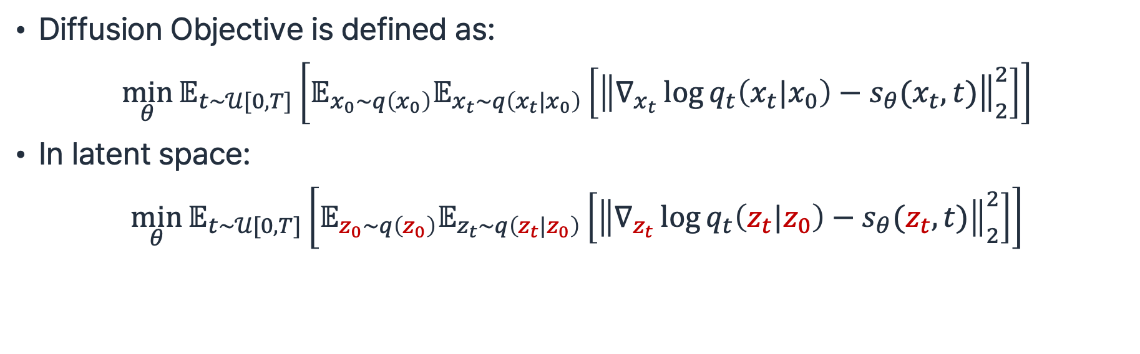
Score-based Diffusion Process
Diffusion Objective is defined as:
$$\min_{θ}{𝔼_{t\sim 𝒰[0,T]}\left[𝔼_{x_{0}\sim q\left(x_{0}\right)}𝔼_{x_{t}\sim q\left(x_{t}|x_{0}\right)}\left[{\left\|∇_{x_{t}}\log{q_{t}\left(x_{t}|x_{0}\right)}−s_{θ}(x_{t},t)\right\|}_{2}^{2}\right]\right]}$$
In latent space:
$$\min_{θ}{𝔼_{t\sim 𝒰[0,T]}\left[𝔼_{z_{0}\sim q\left(z_{0}\right)}𝔼_{z_{t}\sim q\left(z_{t}|z_{0}\right)}\left[{\left\|∇_{z_{t}}\log{q_{t}\left(z_{t}|z_{0}\right)}−s_{θ}(z_{t},t)\right\|}_{2}^{2}\right]\right]}$$
A. Vahdat et al., “Score-based Generative Modeling in Latent Space”, NeurIPS 2021.

Slide 36
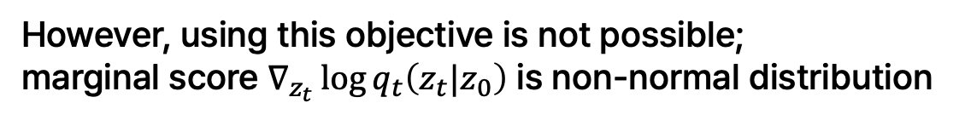
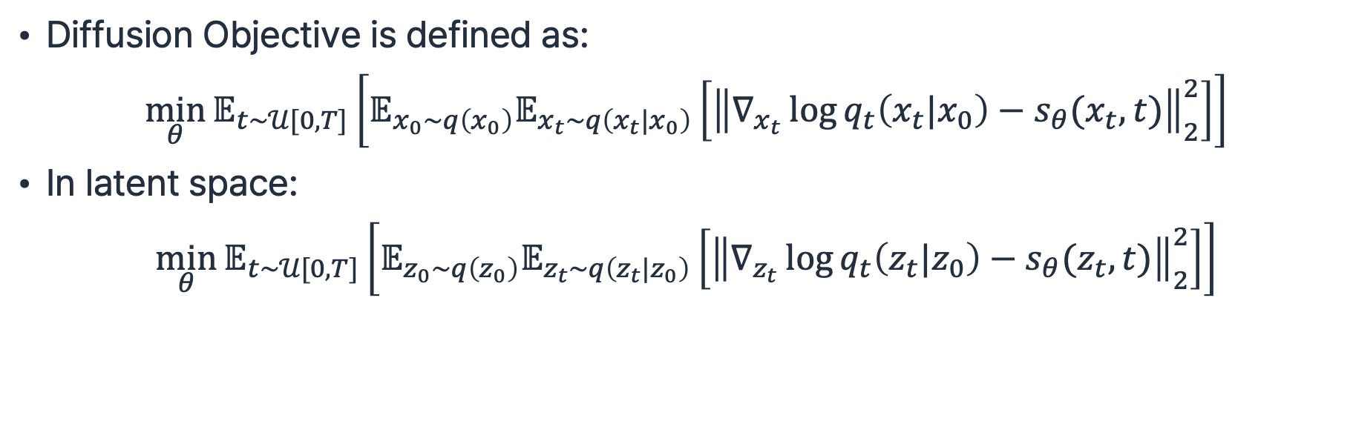
Score-based Diffusion Process
Diffusion Objective is defined as:
$$\min_{θ}{𝔼_{t\sim 𝒰[0,T]}\left[𝔼_{x_{0}\sim q\left(x_{0}\right)}𝔼_{x_{t}\sim q\left(x_{t}|x_{0}\right)}\left[{\left\|∇_{x_{t}}\log{q_{t}\left(x_{t}|x_{0}\right)}−s_{θ}(x_{t},t)\right\|}_{2}^{2}\right]\right]}$$
In latent space:
$$\min_{θ}{𝔼_{t\sim 𝒰[0,T]}\left[𝔼_{z_{0}\sim q\left(z_{0}\right)}𝔼_{z_{t}\sim q\left(z_{t}|z_{0}\right)}\left[{\left\|∇_{z_{t}}\log{q_{t}\left(z_{t}|z_{0}\right)}−s_{θ}(z_{t},t)\right\|}_{2}^{2}\right]\right]}$$
However, using this objective is not possible;
marginal score $∇_{z_{t}}\log{q_{t}\left(z_{t}|z_{0}\right)}$ is non-normal distribution
A. Vahdat et al., “Score-based Generative Modeling in Latent Space”, NeurIPS 2021.

Slide 37

Score-based Diffusion Process
Diffusion Objective is defined as:
$$\min_{θ}{𝔼_{t\sim 𝒰[0,T]}\left[𝔼_{x_{0}\sim q\left(x_{0}\right)}𝔼_{x_{t}\sim q\left(x_{t}|x_{0}\right)}\left[{\left\|∇_{x_{t}}\log{q_{t}\left(x_{t}|x_{0}\right)}−s_{θ}(x_{t},t)\right\|}_{2}^{2}\right]\right]}$$
In latent space:
$$\min_{θ}{𝔼_{t\sim 𝒰[0,T]}\left[𝔼_{z_{0}\sim q\left(z_{0}\right)}𝔼_{z_{t}\sim q\left(z_{t}|z_{0}\right)}\left[{\left\|∇_{z_{t}}\log{q_{t}\left(z_{t}|z_{0}\right)}−s_{θ}(z_{t},t)\right\|}_{2}^{2}\right]\right]}$$
However, using this objective is not possible;
marginal score $∇_{z_{t}}\log{q_{t}\left(z_{t}|z_{0}\right)}$ is non-normal distribution
-> Not able to analytically compute the value
A. Vahdat et al., “Score-based Generative Modeling in Latent Space”, NeurIPS 2021.

Slide 38

LSGM Loss
Goal: Use the score function $∇_{z_{t}}\log{p_{θ}\left(z_{t}\right)}$ to sample $z_{0}$
A. Vahdat et al., “Score-based Generative Modeling in Latent Space”, NeurIPS 2021.

Slide 39
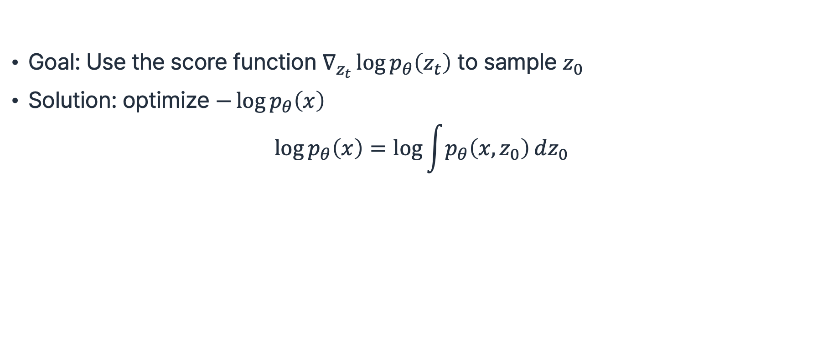
LSGM Loss
Goal: Use the score function $∇_{z_{t}}\log{p_{θ}\left(z_{t}\right)}$ to sample $z_{0}$
Solution: optimize $−\log{p_{θ}\left(x\right)}$
$$\log{p_{θ}\left(x\right)}=\log{\int{p_{θ}\left(x,z_{0}\right)}dz_{0}}$$
A. Vahdat et al., “Score-based Generative Modeling in Latent Space”, NeurIPS 2021.

Slide 40
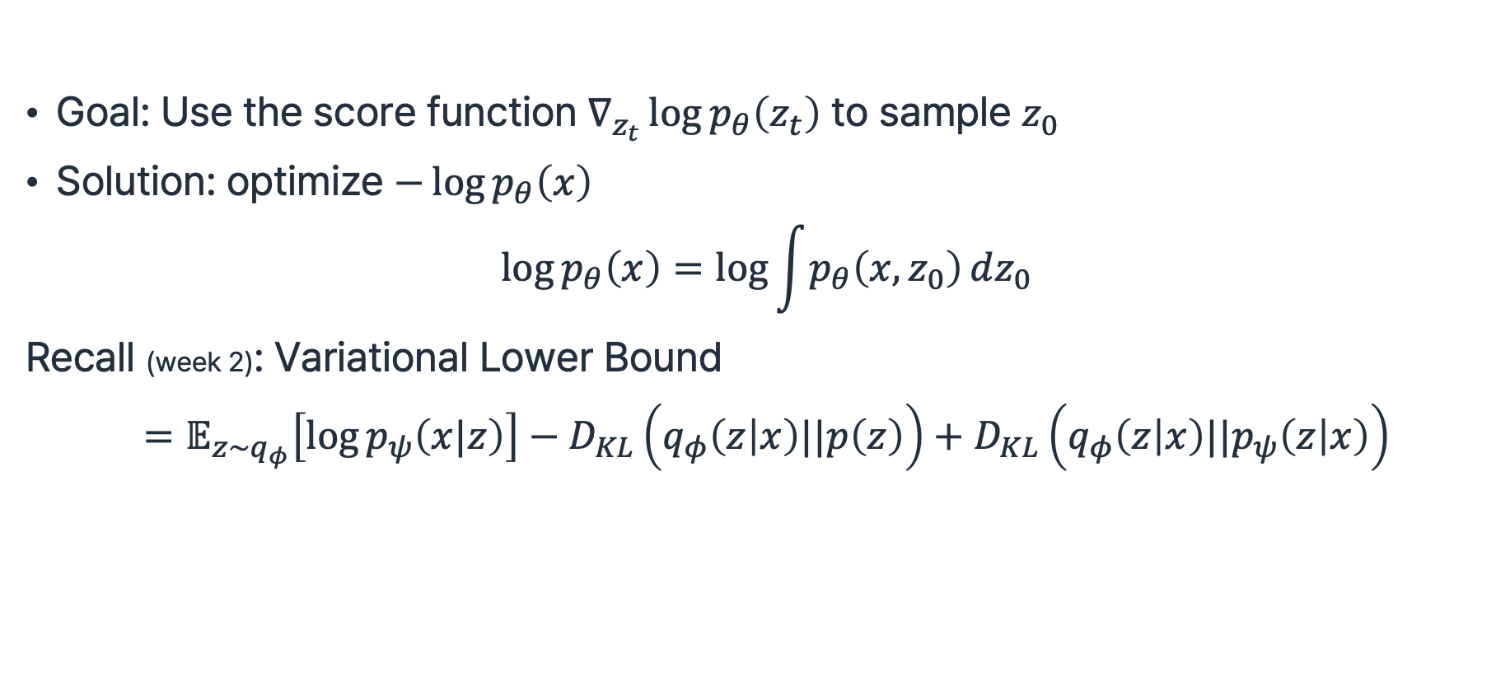
LSGM Loss
Goal: Use the score function $∇_{z_{t}}\log{p_{θ}\left(z_{t}\right)}$ to sample $z_{0}$
Solution: optimize $−\log{p_{θ}\left(x\right)}$
$$\log{p_{θ}\left(x\right)}=\log{\int{p_{θ}\left(x,z_{0}\right)}dz_{0}}$$
Recall (week 2): Variational Lower Bound
$$=𝔼_{z\sim q_{φ}}\left[\log{p_{ψ}\left(x|z\right)}\right]−D_{KL}\left(q_{φ}\left(z | x\right)||p\left(z\right)\right)+D_{KL}\left(q_{φ}\left(z | x\right)||p_{ψ}\left(z | x\right)\right)$$
Reconstruction term
Prior / Encoder KL Divergence
Intractable
A. Vahdat et al., “Score-based Generative Modeling in Latent Space”, NeurIPS 2021.

Slide 41
LSGM Loss
Goal: Use the score function $∇_{z_{t}}\log{p_{θ}\left(z_{t}\right)}$ to sample $z_{0}$
Solution: optimize $−\log{p_{θ}\left(x\right)}$
$$\log{p_{θ}\left(x\right)}=\log{\int{p_{θ}\left(x,z_{0}\right)}dz_{0}}$$
Recall (week 2): Variational Lower Bound
$$=𝔼_{z\sim q_{φ}}\left[\log{p_{ψ}\left(x|z\right)}\right]−D_{KL}\left(q_{φ}\left(z | x\right)||p\left(z\right)\right)+D_{KL}\left(q_{φ}\left(z | x\right)||p_{ψ}\left(z | x\right)\right)$$
Reconstruction term
Prior / Encoder KL Divergence
Intractable
We have three components:
A. Vahdat et al., “Score-based Generative Modeling in Latent Space”, NeurIPS 2021.

Slide 42
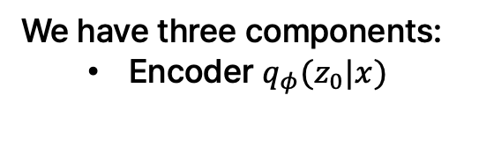
LSGM Loss
Goal: Use the score function $∇_{z_{t}}\log{p_{θ}\left(z_{t}\right)}$ to sample $z_{0}$
Solution: optimize $−\log{p_{θ}\left(x\right)}$
$$\log{p_{θ}\left(x\right)}=\log{\int{p_{θ}\left(x,z_{0}\right)}dz_{0}}$$
Recall (week 2): Variational Lower Bound
$$=𝔼_{z\sim q_{φ}}\left[\log{p_{ψ}\left(x|z\right)}\right]−D_{KL}\left(q_{φ}\left(z | x\right)||p\left(z\right)\right)+D_{KL}\left(q_{φ}\left(z | x\right)||p_{ψ}\left(z | x\right)\right)$$
Reconstruction term
Prior / Encoder KL Divergence
Intractable
We have three components:
  Encoder $q_{φ}(z_{0}|x)$
A. Vahdat et al., “Score-based Generative Modeling in Latent Space”, NeurIPS 2021.

Slide 43
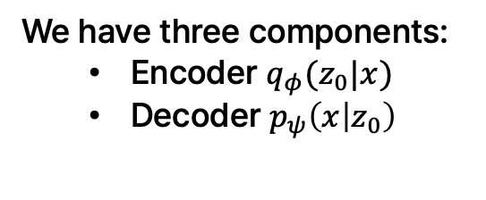
LSGM Loss
Goal: Use the score function $∇_{z_{t}}\log{p_{θ}\left(z_{t}\right)}$ to sample $z_{0}$
Solution: optimize $−\log{p_{θ}\left(x\right)}$
$$\log{p_{θ}\left(x\right)}=\log{\int{p_{θ}\left(x,z_{0}\right)}dz_{0}}$$
Recall (week 2): Variational Lower Bound
$$=𝔼_{z\sim q_{φ}}\left[\log{p_{ψ}\left(x|z\right)}\right]−D_{KL}\left(q_{φ}\left(z | x\right)||p\left(z\right)\right)+D_{KL}\left(q_{φ}\left(z | x\right)||p_{ψ}\left(z | x\right)\right)$$
Reconstruction term
Prior / Encoder KL Divergence
Intractable
We have three components:
  Encoder $q_{φ}(z_{0}|x)$
  Decoder $p_{ψ}\left(x | z_{0}\right)$
A. Vahdat et al., “Score-based Generative Modeling in Latent Space”, NeurIPS 2021.

Slide 44
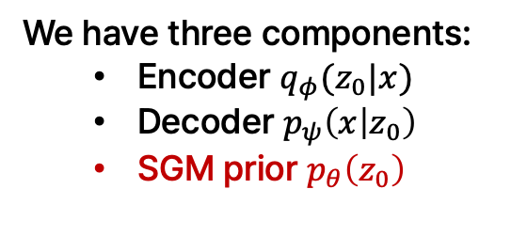
LSGM Loss
Goal: Use the score function $∇_{z_{t}}\log{p_{θ}\left(z_{t}\right)}$ to sample $z_{0}$
Solution: optimize $−\log{p_{θ}\left(x\right)}$
$$\log{p_{θ}\left(x\right)}=\log{\int{p_{θ}\left(x,z_{0}\right)}dz_{0}}$$
Recall (week 2): Variational Lower Bound
$$=𝔼_{z\sim q_{φ}}\left[\log{p_{ψ}\left(x|z\right)}\right]−D_{KL}\left(q_{φ}\left(z | x\right)||p\left(z\right)\right)+D_{KL}\left(q_{φ}\left(z | x\right)||p_{ψ}\left(z | x\right)\right)$$
Reconstruction term
Prior / Encoder KL Divergence
Intractable
We have three components:
  Encoder $q_{φ}(z_{0}|x)$
  Decoder $p_{ψ}\left(x | z_{0}\right)$
  SGM prior $p_{θ}\left(z_{0}\right)$
A. Vahdat et al., “Score-based Generative Modeling in Latent Space”, NeurIPS 2021.

Slide 45
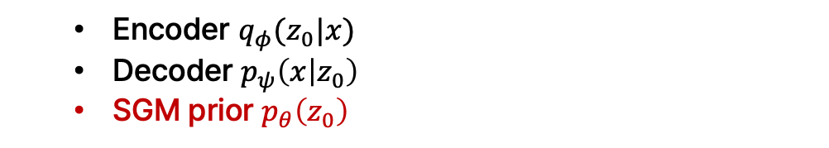
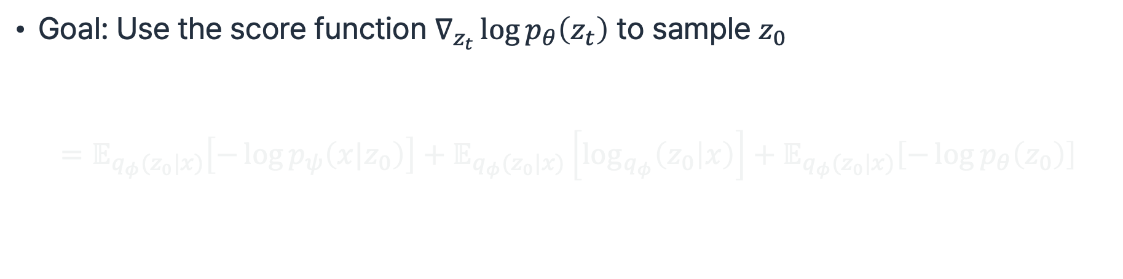
LSGM Loss
  Encoder $q_{φ}(z_{0}|x)$
  Decoder $p_{ψ}\left(x | z_{0}\right)$
  SGM prior $p_{θ}\left(z_{0}\right)$
Goal: Use the score function $∇_{z_{t}}\log{p_{θ}\left(z_{t}\right)}$ to sample $z_{0}$
$$=𝔼_{q_{φ}(z_{0}|x)}\left[−\log{p_{ψ}\left(x|z_{0}\right)}\right]+𝔼_{q_{φ}(z_{0}|x)}\left[\log_{q_{φ}}\left(z_{0} | x\right)\right]+𝔼_{q_{φ}(z_{0}|x)}\left[−\log{p_{θ}\left(z_{0}\right)}\right]$$
A. Vahdat et al., “Score-based Generative Modeling in Latent Space”, NeurIPS 2021.

Slide 46
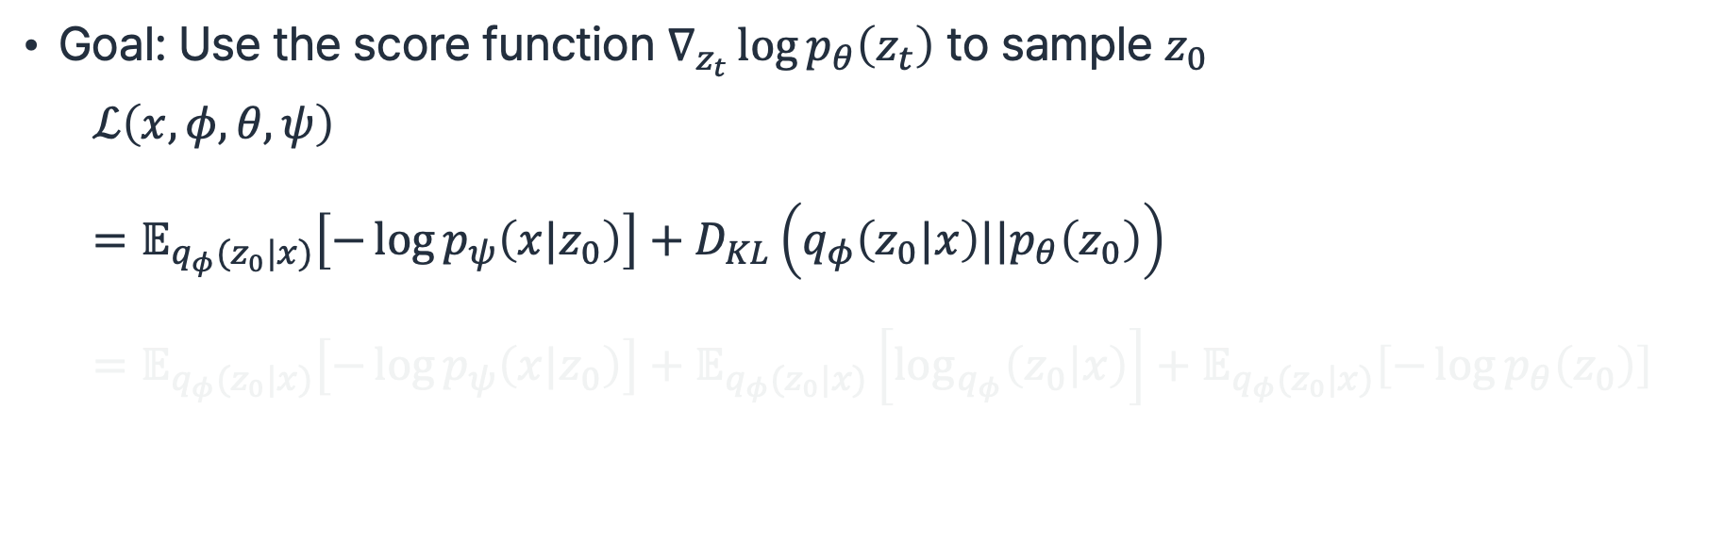
LSGM Loss
  Encoder $q_{φ}(z_{0}|x)$
  Decoder $p_{ψ}\left(x | z_{0}\right)$
  SGM prior $p_{θ}\left(z_{0}\right)$
Goal: Use the score function $∇_{z_{t}}\log{p_{θ}\left(z_{t}\right)}$ to sample $z_{0}$
$$ℒ\left(x,φ,θ,ψ\right) \\ =𝔼_{q_{φ}(z_{0}|x)}\left[−\log{p_{ψ}\left(x|z_{0}\right)}\right]+D_{KL}\left(q_{φ}\left(z_{0}|x\right)||p_{θ}\left(z_{0}\right)\right) \\ =𝔼_{q_{φ}(z_{0}|x)}\left[−\log{p_{ψ}\left(x|z_{0}\right)}\right]+𝔼_{q_{φ}(z_{0}|x)}\left[\log_{q_{φ}}\left(z_{0} | x\right)\right]+𝔼_{q_{φ}(z_{0}|x)}\left[−\log{p_{θ}\left(z_{0}\right)}\right]$$
A. Vahdat et al., “Score-based Generative Modeling in Latent Space”, NeurIPS 2021.

Slide 47
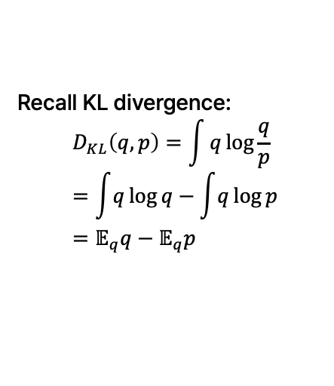
LSGM Loss
  Encoder $q_{φ}(z_{0}|x)$
  Decoder $p_{ψ}\left(x | z_{0}\right)$
  SGM prior $p_{θ}\left(z_{0}\right)$
Goal: Use the score function $∇_{z_{t}}\log{p_{θ}\left(z_{t}\right)}$ to sample $z_{0}$
$$ℒ\left(x,φ,θ,ψ\right) \\ =𝔼_{q_{φ}(z_{0}|x)}\left[−\log{p_{ψ}\left(x|z_{0}\right)}\right]+D_{KL}\left(q_{φ}\left(z_{0}|x\right)||p_{θ}\left(z_{0}\right)\right) \\ =𝔼_{q_{φ}(z_{0}|x)}\left[−\log{p_{ψ}\left(x|z_{0}\right)}\right]+𝔼_{q_{φ}(z_{0}|x)}\left[\log_{q_{φ}}\left(z_{0} | x\right)\right]+𝔼_{q_{φ}(z_{0}|x)}\left[−\log{p_{θ}\left(z_{0}\right)}\right]$$
Recall KL divergence:
$$D_{KL}\left(q,p\right)=\int{q\log{\frac{q}{p}}} \\ =\int{q\log{q}}−\int{q\log{p}} \\ =𝔼_{q}q−𝔼_{q}p$$
A. Vahdat et al., “Score-based Generative Modeling in Latent Space”, NeurIPS 2021.

Slide 48
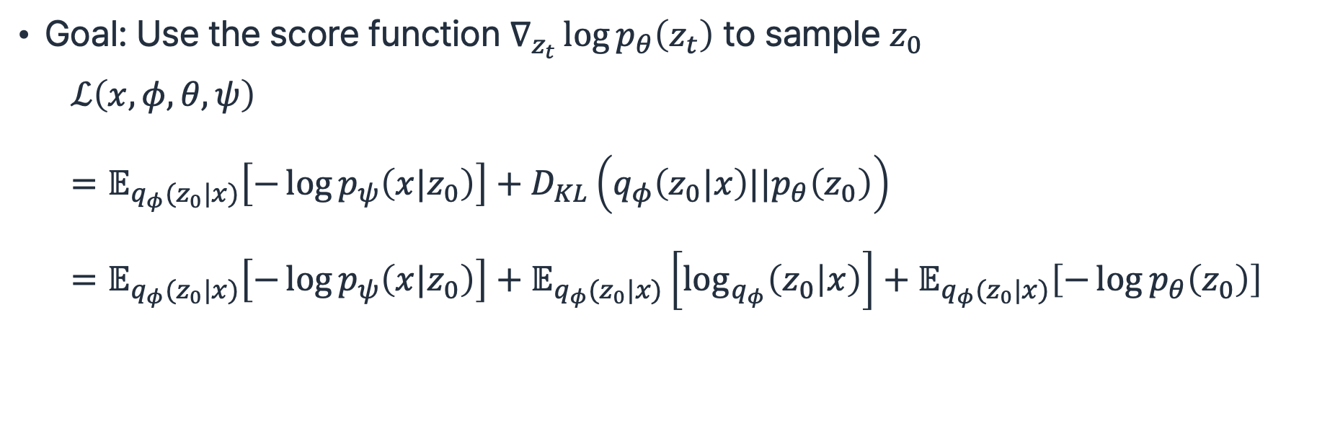
LSGM Loss
  Encoder $q_{φ}(z_{0}|x)$
  Decoder $p_{ψ}\left(x | z_{0}\right)$
  SGM prior $p_{θ}\left(z_{0}\right)$
Goal: Use the score function $∇_{z_{t}}\log{p_{θ}\left(z_{t}\right)}$ to sample $z_{0}$
$$ℒ\left(x,φ,θ,ψ\right) \\ =𝔼_{q_{φ}(z_{0}|x)}\left[−\log{p_{ψ}\left(x|z_{0}\right)}\right]+D_{KL}\left(q_{φ}\left(z_{0}|x\right)||p_{θ}\left(z_{0}\right)\right) \\ =𝔼_{q_{φ}(z_{0}|x)}\left[−\log{p_{ψ}\left(x|z_{0}\right)}\right]+𝔼_{q_{φ}(z_{0}|x)}\left[\log_{q_{φ}}\left(z_{0} | x\right)\right]+𝔼_{q_{φ}(z_{0}|x)}\left[−\log{p_{θ}\left(z_{0}\right)}\right]$$
Recall KL divergence:
$$D_{KL}\left(q,p\right)=\int{q\log{\frac{q}{p}}} \\ =\int{q\log{q}}−\int{q\log{p}} \\ =𝔼_{q}q−𝔼_{q}p$$
A. Vahdat et al., “Score-based Generative Modeling in Latent Space”, NeurIPS 2021.

Slide 49
LSGM Loss
  Encoder $q_{φ}(z_{0}|x)$
  Decoder $p_{ψ}\left(x | z_{0}\right)$
  SGM prior $p_{θ}\left(z_{0}\right)$
Goal: Use the score function $∇_{z_{t}}\log{p_{θ}\left(z_{t}\right)}$ to sample $z_{0}$
$$ℒ\left(x,φ,θ,ψ\right) \\ =𝔼_{q_{φ}(z_{0}|x)}\left[−\log{p_{ψ}\left(x|z_{0}\right)}\right]+D_{KL}\left(q_{φ}\left(z_{0}|x\right)||p_{θ}\left(z_{0}\right)\right) \\ =𝔼_{q_{φ}(z_{0}|x)}\left[−\log{p_{ψ}\left(x|z_{0}\right)}\right]+𝔼_{q_{φ}(z_{0}|x)}\left[\log_{q_{φ}}\left(z_{0} | x\right)\right]+𝔼_{q_{φ}(z_{0}|x)}\left[−\log{p_{θ}\left(z_{0}\right)}\right]$$
Recall KL divergence:
$$D_{KL}\left(q,p\right)=\int{q\log{\frac{q}{p}}} \\ =\int{q\log{q}}−\int{q\log{p}} \\ =𝔼_{q}q−𝔼_{q}p$$
Reconstruction term
Negative encoder entropy
Cross entropy
A. Vahdat et al., “Score-based Generative Modeling in Latent Space”, NeurIPS 2021.

Slide 50
LSGM Loss
  Encoder $q_{φ}(z_{0}|x)$
  Decoder $p_{ψ}\left(x | z_{0}\right)$
  SGM prior $p_{θ}\left(z_{0}\right)$
Goal: Use the score function $∇_{z_{t}}\log{p_{θ}\left(z_{t}\right)}$ to sample $z_{0}$
$$ℒ\left(x,φ,θ,ψ\right) \\ =𝔼_{q_{φ}(z_{0}|x)}\left[−\log{p_{ψ}\left(x|z_{0}\right)}\right]+D_{KL}\left(q_{φ}\left(z_{0}|x\right)||p_{θ}\left(z_{0}\right)\right) \\ =𝔼_{q_{φ}(z_{0}|x)}\left[−\log{p_{ψ}\left(x|z_{0}\right)}\right]+𝔼_{q_{φ}(z_{0}|x)}\left[\log_{q_{φ}}\left(z_{0} | x\right)\right]+𝔼_{q_{φ}(z_{0}|x)}\left[−\log{p_{θ}\left(z_{0}\right)}\right]$$
Recall KL divergence:
$$D_{KL}\left(q,p\right)=\int{q\log{\frac{q}{p}}} \\ =\int{q\log{q}}−\int{q\log{p}} \\ =𝔼_{q}q−𝔼_{q}p$$
Reconstruction term
Negative encoder entropy
Cross entropy
Estimated by encoder and decoder
A. Vahdat et al., “Score-based Generative Modeling in Latent Space”, NeurIPS 2021.

Slide 51
LSGM Loss
  Encoder $q_{φ}(z_{0}|x)$
  Decoder $p_{ψ}\left(x | z_{0}\right)$
  SGM prior $p_{θ}\left(z_{0}\right)$
Goal: Use the score function $∇_{z_{t}}\log{p_{θ}\left(z_{t}\right)}$ to sample $z_{0}$
$$ℒ\left(x,φ,θ,ψ\right) \\ =𝔼_{q_{φ}(z_{0}|x)}\left[−\log{p_{ψ}\left(x|z_{0}\right)}\right]+D_{KL}\left(q_{φ}\left(z_{0}|x\right)||p_{θ}\left(z_{0}\right)\right) \\ =𝔼_{q_{φ}(z_{0}|x)}\left[−\log{p_{ψ}\left(x|z_{0}\right)}\right]+𝔼_{q_{φ}(z_{0}|x)}\left[\log_{q_{φ}}\left(z_{0} | x\right)\right]+𝔼_{q_{φ}(z_{0}|x)}\left[−\log{p_{θ}\left(z_{0}\right)}\right]$$
Recall KL divergence:
$$D_{KL}\left(q,p\right)=\int{q\log{\frac{q}{p}}} \\ =\int{q\log{q}}−\int{q\log{p}} \\ =𝔼_{q}q−𝔼_{q}p$$
Reconstruction term
Negative encoder entropy
Cross entropy
Estimated by encoder and decoder
How do we optimize this?
A. Vahdat et al., “Score-based Generative Modeling in Latent Space”, NeurIPS 2021.

Slide 52
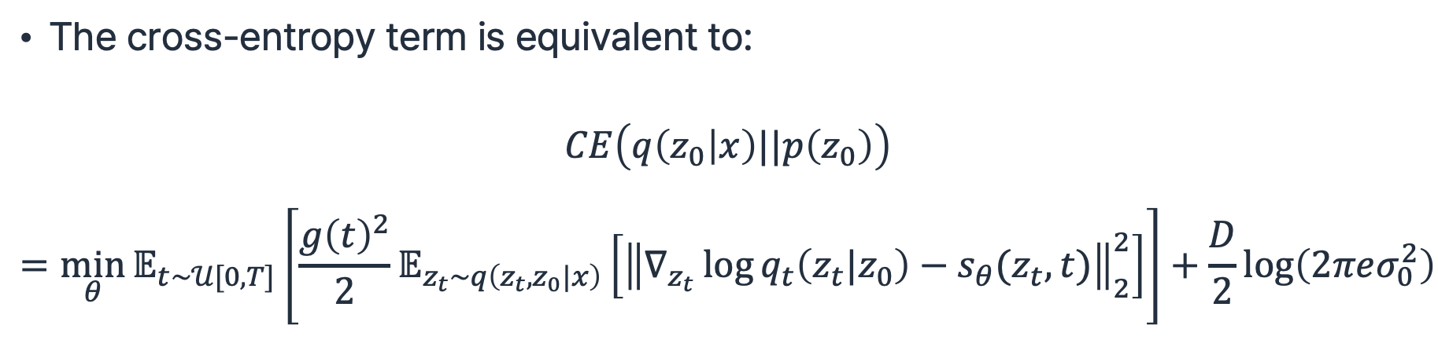
LSGM Loss: The Cross Entropy Term
The cross-entropy term is equivalent to:
$$CE\left(q\left(z_{0} | x\right)||p\left(z_{0}\right)\right)$$
$$=\min_{θ}{𝔼_{t\sim 𝒰[0,T]}\left[\frac{g{\left(t\right)}^{2}}{2}𝔼_{z_{t}\sim q\left(z_{t}{,z}_{0}|x\right)}\left[{\left\|∇_{z_{t}}\log{q_{t}\left(z_{t}|z_{0}\right)}−s_{θ}(z_{t},t)\right\|}_{2}^{2}\right]\right]+\frac{D}{2}\log\left(2πeσ_{0}^{2}\right)}$$
A. Vahdat et al., “Score-based Generative Modeling in Latent Space”, NeurIPS 2021.

Slide 53
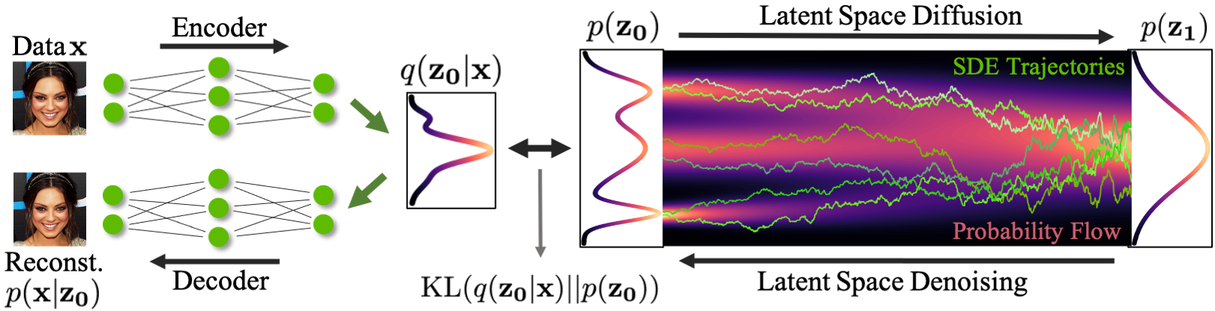
Score-based Generation in Latent Space
A. Vahdat et al., “Score-based Generative Modeling in Latent Space”, NeurIPS 2021.

Slide 54
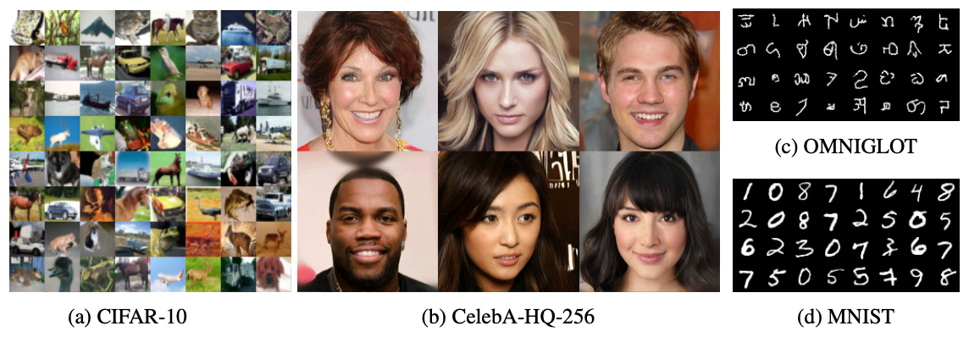
LSGM Results
A. Vahdat et al., “Score-based Generative Modeling in Latent Space”, NeurIPS 2021.

Slide 55
Discrete Diffusion Models

Slide 56
Discrete Space Transition
When the output space is discrete, forward pass can be interpreted as transition
J. Austin et al., “Structured Denoising Diffusion Models in Discrete State-Spaces”, NeurIPS 2021.

Slide 57
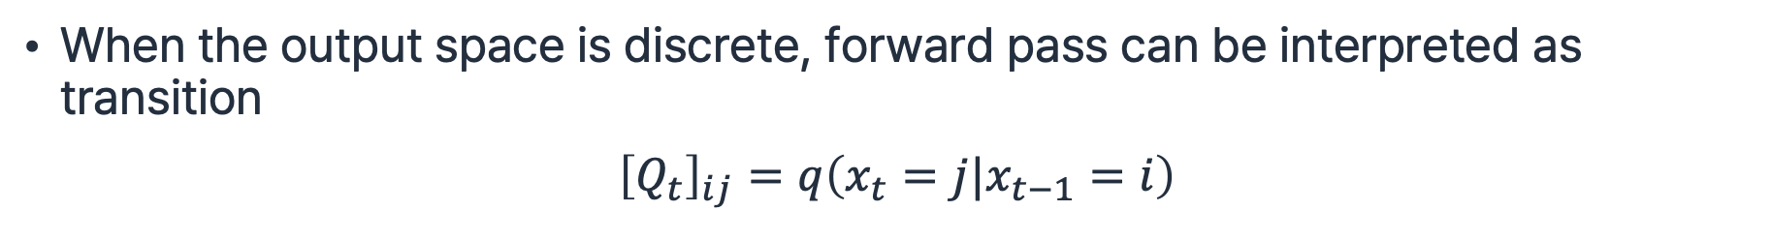
Discrete Space Transition
When the output space is discrete, forward pass can be interpreted as transition
$${\left[Q_{t}\right]}_{ij}=q\left(x_{t}=j|x_{t−1}=i\right)$$
J. Austin et al., “Structured Denoising Diffusion Models in Discrete State-Spaces”, NeurIPS 2021.

Slide 58
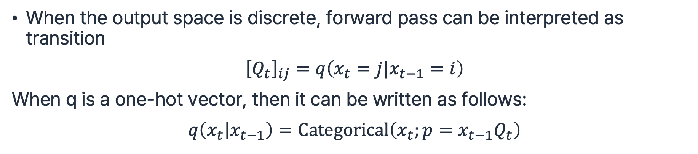
Discrete Space Transition
When the output space is discrete, forward pass can be interpreted as transition
$${\left[Q_{t}\right]}_{ij}=q\left(x_{t}=j|x_{t−1}=i\right)$$
When q is a one-hot vector, then it can be written as follows:
$$q\left(x_{t} | x_{t−1}\right)=Categorical\left(x_{t};p=x_{t−1}Q_{t}\right)$$
J. Austin et al., “Structured Denoising Diffusion Models in Discrete State-Spaces”, NeurIPS 2021.

Slide 59
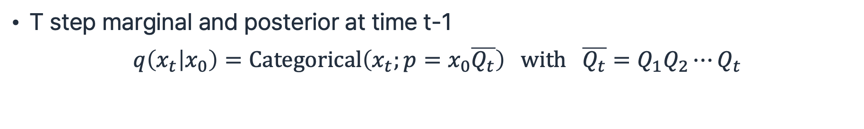
Discrete Space Transition
T step marginal and posterior at time t-1
$$q\left(x_{t} | x_{0}\right)=Categorical\left(x_{t};p=x_{0}\overline{Q_{t}}\right) with \overline{Q_{t}}=Q_{1}Q_{2}⋯Q_{t}$$
J. Austin et al., “Structured Denoising Diffusion Models in Discrete State-Spaces”, NeurIPS 2021.

Slide 60
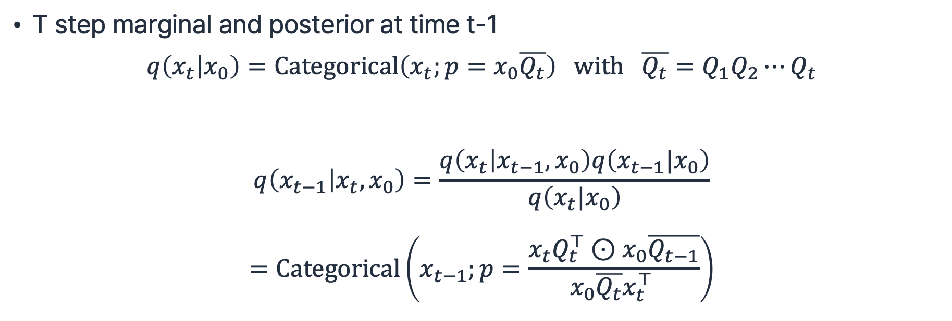
Discrete Space Transition
T step marginal and posterior at time t-1
$$q\left(x_{t} | x_{0}\right)=Categorical\left(x_{t};p=x_{0}\overline{Q_{t}}\right) with \overline{Q_{t}}=Q_{1}Q_{2}⋯Q_{t}$$
$$q\left(x_{t−1} | x_{t},x_{0}\right)=\frac{q\left(x_{t} | x_{t−1},x_{0}\right)q\left(x_{t−1}|x_{0}\right)}{q\left(x_{t}|x_{0}\right)}$$
$$=Categorical\left(x_{t−1};p=\frac{x_{t}Q_{t}^{⊤}⊙x_{0}\overline{Q_{t−1}}}{x_{0}\overline{Q_{t}}x_{t}^{⊤} }\right)$$
J. Austin et al., “Structured Denoising Diffusion Models in Discrete State-Spaces”, NeurIPS 2021.

Slide 61
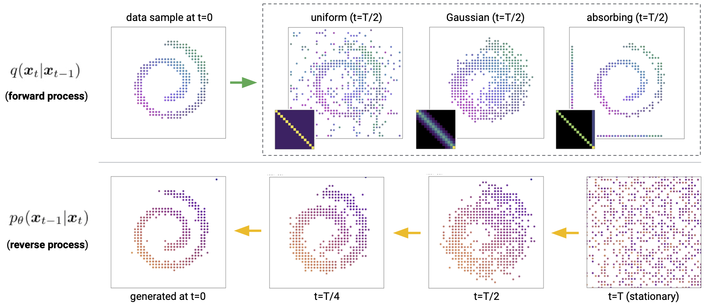
Transition Matrices
J. Austin et al., “Structured Denoising Diffusion Models in Discrete State-Spaces”, NeurIPS 2021.

Slide 62
Everything is a Diffusion Model
J. Austin et al., “Structured Denoising Diffusion Models in Discrete State-Spaces”, NeurIPS 2021.

Slide 63
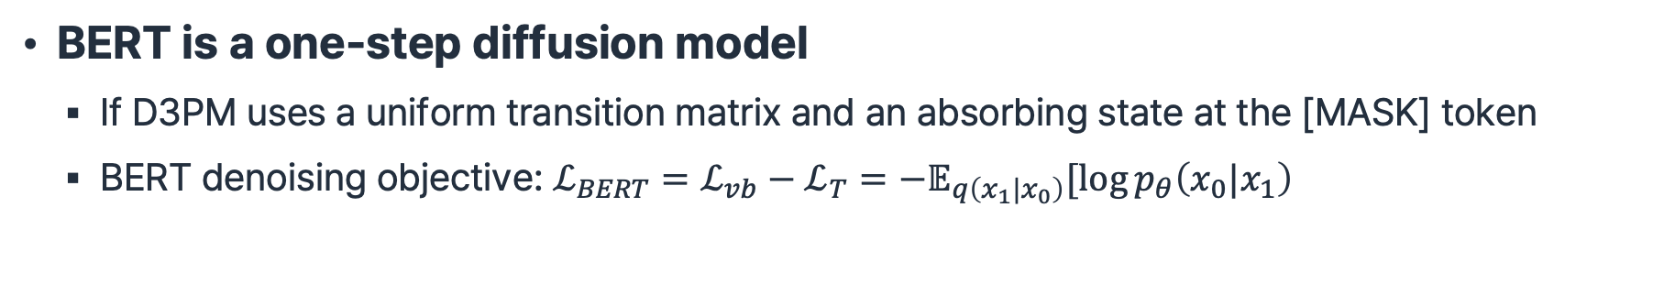
Everything is a Diffusion Model
BERT is a one-step diffusion model
  If D3PM uses a uniform transition matrix and an absorbing state at the [MASK] token
  BERT denoising objective: $ℒ_{BERT}=ℒ_{vb}−ℒ_{T}=−𝔼_{q\left(x_{1}|x_{0}\right)}[\log{p_{θ}\left(x_{0}|x_{1}\right)}$
J. Austin et al., “Structured Denoising Diffusion Models in Discrete State-Spaces”, NeurIPS 2021.

Slide 64
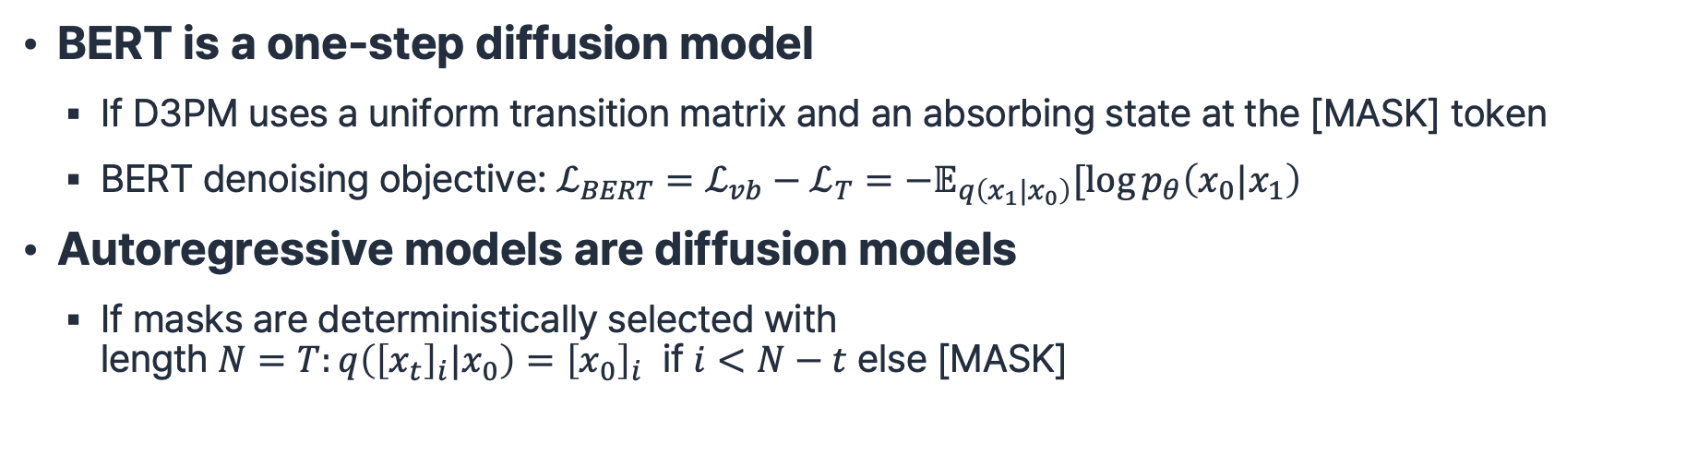
Everything is a Diffusion Model
BERT is a one-step diffusion model
  If D3PM uses a uniform transition matrix and an absorbing state at the [MASK] token
  BERT denoising objective: $ℒ_{BERT}=ℒ_{vb}−ℒ_{T}=−𝔼_{q\left(x_{1}|x_{0}\right)}[\log{p_{θ}\left(x_{0}|x_{1}\right)}$
Autoregressive models are diffusion models
  If masks are deterministically selected with
  length $N=T:q\left({\left[x_{t}\right]}_{i}|x_{0}\right)={\left[x_{0}\right]}_{i}$ if $i<N−t$ else [MASK]
J. Austin et al., “Structured Denoising Diffusion Models in Discrete State-Spaces”, NeurIPS 2021.

Slide 65
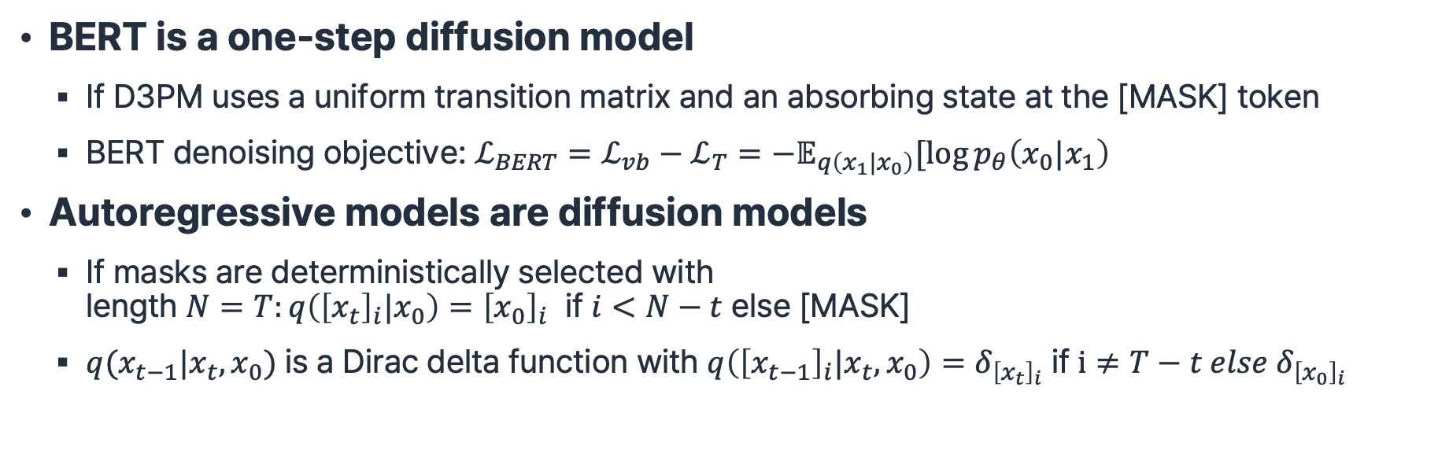
Everything is a Diffusion Model
BERT is a one-step diffusion model
  If D3PM uses a uniform transition matrix and an absorbing state at the [MASK] token
  BERT denoising objective: $ℒ_{BERT}=ℒ_{vb}−ℒ_{T}=−𝔼_{q\left(x_{1}|x_{0}\right)}[\log{p_{θ}\left(x_{0}|x_{1}\right)}$
Autoregressive models are diffusion models
  If masks are deterministically selected with
  length $N=T:q\left({\left[x_{t}\right]}_{i}|x_{0}\right)={\left[x_{0}\right]}_{i}$ if $i<N−t$ else [MASK]
  $q(x_{t−1}|x_{t},x_{0})$ is a Dirac delta function with $q\left({\left[x_{t−1}\right]}_{i}|x_{t},x_{0}\right)=δ_{{\left[x_{t}\right]}_{i}}$ if $i≠T−t else δ_{{\left[x_{0}\right]}_{i}}$
J. Austin et al., “Structured Denoising Diffusion Models in Discrete State-Spaces”, NeurIPS 2021.

Slide 66
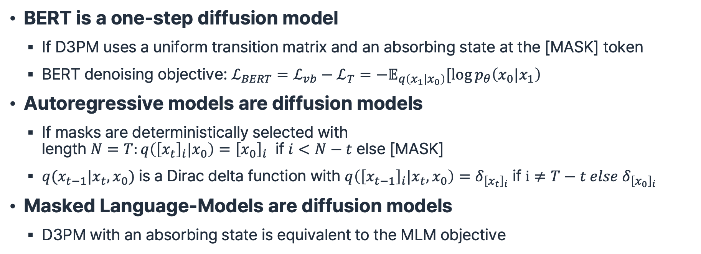
Everything is a Diffusion Model
BERT is a one-step diffusion model
  If D3PM uses a uniform transition matrix and an absorbing state at the [MASK] token
  BERT denoising objective: $ℒ_{BERT}=ℒ_{vb}−ℒ_{T}=−𝔼_{q\left(x_{1}|x_{0}\right)}[\log{p_{θ}\left(x_{0}|x_{1}\right)}$
Autoregressive models are diffusion models
  If masks are deterministically selected with
  length $N=T:q\left({\left[x_{t}\right]}_{i}|x_{0}\right)={\left[x_{0}\right]}_{i}$ if $i<N−t$ else [MASK]
  $q(x_{t−1}|x_{t},x_{0})$ is a Dirac delta function with $q\left({\left[x_{t−1}\right]}_{i}|x_{t},x_{0}\right)=δ_{{\left[x_{t}\right]}_{i}}$ if $i≠T−t else δ_{{\left[x_{0}\right]}_{i}}$
Masked Language-Models are diffusion models
  D3PM with an absorbing state is equivalent to the MLM objective
J. Austin et al., “Structured Denoising Diffusion Models in Discrete State-Spaces”, NeurIPS 2021.

Slide 67
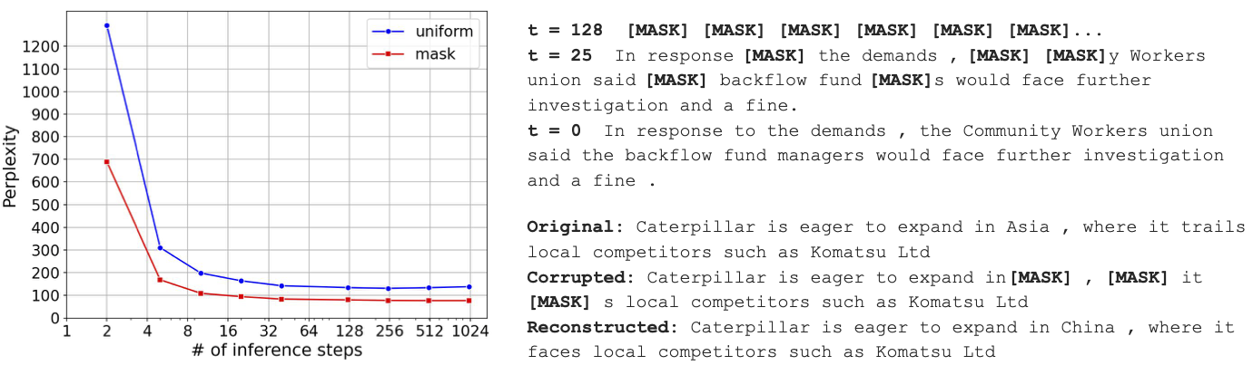
D3PM Language Generation
J. Austin et al., “Structured Denoising Diffusion Models in Discrete State-Spaces”, NeurIPS 2021.

Slide 68

D3PM Image Generation
J. Austin et al., “Structured Denoising Diffusion Models in Discrete State-Spaces”, NeurIPS 2021.

Slide 69
VQ-Diffusion
Goal: Generate image using discrete diffusion model
S. Gu et al., “Vector Quantized Diffusion Model for Text-to-Image Synthesis”, CVPR 2022 Oral.

Slide 70
VQ-Diffusion
Goal: Generate image using discrete diffusion model
AR models assume conditional independence in images, which may not be true
S. Gu et al., “Vector Quantized Diffusion Model for Text-to-Image Synthesis”, CVPR 2022 Oral.

Slide 71
VQ-Diffusion
Goal: Generate image using discrete diffusion model
AR models assume conditional independence in images, which may not be true
Plus, use a latent space for the diffusion model
S. Gu et al., “Vector Quantized Diffusion Model for Text-to-Image Synthesis”, CVPR 2022 Oral.

Slide 72
VQ-Diffusion
Goal: Generate image using discrete diffusion model
AR models assume conditional independence in images, which may not be true
Plus, use a latent space for the diffusion model
Problem: latent space is not quite suitable for MDM
S. Gu et al., “Vector Quantized Diffusion Model for Text-to-Image Synthesis”, CVPR 2022 Oral.

Slide 73
VQ-Diffusion
Goal: Generate image using discrete diffusion model
AR models assume conditional independence in images, which may not be true
Plus, use a latent space for the diffusion model
Problem: latent space is not quite suitable for MDM
  Use discrete representation of image latent space
S. Gu et al., “Vector Quantized Diffusion Model for Text-to-Image Synthesis”, CVPR 2022 Oral.

Slide 74

Prerequisites: VQ-VAE
A. van den Oord et al., “Neural Discrete Representation Learning”, NIPS 2017.

Slide 75
Prerequisites: VQ-VAE
An image $x∈ℝ^{H×W×3}$ is encoded into a code $e_{k}$
A. van den Oord et al., “Neural Discrete Representation Learning”, NIPS 2017.

Slide 76

Prerequisites: VQ-VAE
An image $x∈ℝ^{H×W×3}$ is encoded into a code $e_{k}$
$$q\left(z=k | x\right)=\left\{\begin{aligned}1 for k=\arg{\min_{j}{{\left\|z_{e}\left(x\right)−e_{j}\right\|}_{2}^{2}}} \\ 0 otherwise \end{aligned}\right.$$
A. van den Oord et al., “Neural Discrete Representation Learning”, NIPS 2017.

Slide 77

Prerequisites: VQ-VAE
An image $x∈ℝ^{H×W×3}$ is encoded into a code $e_{k}$
$$q\left(z=k | x\right)=\left\{\begin{aligned}1 for k=\arg{\min_{j}{{\left\|z_{e}\left(x\right)−e_{j}\right\|}_{2}^{2}}} \\ 0 otherwise \end{aligned}\right.$$
$$z_{q}\left(x\right)=e_{k} where k=\arg{{\min_{j}\left\|z_{e}\left(x\right)−e_{j}\right\|}_{2}^{2}}$$
A. van den Oord et al., “Neural Discrete Representation Learning”, NIPS 2017.

Slide 78

Vector Quantization
Goal: Generate image
  Training process discrepancy: $x_{0}$ is not given in the generation process
S. Gu et al., “Vector Quantized Diffusion Model for Text-to-Image Synthesis”, CVPR 2022 Oral.

Slide 79

Vector Quantization
Goal: Generate image from text
  Training process discrepancy: $x_{0}$ is not given in the generation process
  Use text $y$ as a condition and optimize $p(x|y)$
S. Gu et al., “Vector Quantized Diffusion Model for Text-to-Image Synthesis”, CVPR 2022 Oral.

Slide 80

Vector Quantization
Goal: Generate image from text
  Training process discrepancy: $x_{0}$ is not given in the generation process
  Use text $y$ as a condition and optimize $p(x|y)$
The objective function can be defined as:
$$ℒ=\log{p_{θ}\left(x_{0}|x_{1},y\right)} \\ −\sum_{t=1}^{T−1}{D_{KL}\left(q_{φ}\left(x_{t−1} | x_{t},x_{0}\right)||p\left(x_{t−1}|x_{t},y\right)\right)} \\ +D_{KL}\left(q_{φ}\left(x_{T} | x_{0}\right)||p_{ψ}\left(x_{T}\right)\right)$$
S. Gu et al., “Vector Quantized Diffusion Model for Text-to-Image Synthesis”, CVPR 2022 Oral.

Slide 81

Mask-and-Replace
D3PM uses random changing masking strategy:
S. Gu et al., “Vector Quantized Diffusion Model for Text-to-Image Synthesis”, CVPR 2022 Oral.

Slide 82
Mask-and-Replace
D3PM uses random changing masking strategy:
Problem: the model cannot know which tokens are masked
S. Gu et al., “Vector Quantized Diffusion Model for Text-to-Image Synthesis”, CVPR 2022 Oral.

Slide 83

Mask-and-Replace
D3PM uses random changing masking strategy:
Problem: the model cannot know which tokens are masked
Solution: add a new [MASK] token
S. Gu et al., “Vector Quantized Diffusion Model for Text-to-Image Synthesis”, CVPR 2022 Oral.

Slide 84

VQ-Diffusion Architecture
S. Gu et al., “Vector Quantized Diffusion Model for Text-to-Image Synthesis”, CVPR 2022 Oral.

Slide 85

VQ-Diffusion Results
S. Gu et al., “Vector Quantized Diffusion Model for Text-to-Image Synthesis”, CVPR 2022 Oral.

Slide 86
Jihwan Hong
csjihwanh@snu.ac.kr

